Slide 1
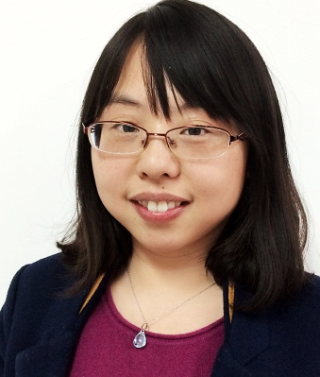
邹潇霄 杭州外国语学校 · 英语教师
从教11年，工作勤勉踏实，热爱教育工作。连续多年被评为校“优秀教育工作者”、“教坛新秀”等荣誉。努力钻研英语课堂教学，撰写发表多篇论文并获奖。
2017年浙江省初中英语课堂教学评比一等奖。
2015年参加杭州电视台“名师公开课”录制。
2011-2013年作为“孔子课堂”教师在美国教学，并取得美国教师资格证。

Slide 2
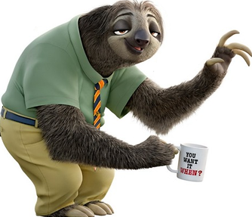
G---O---O---D
M---O---R---N---I---N---G ~
Xiaoxiao Zou
Hangzhou Foreign Languages School

Slide 3
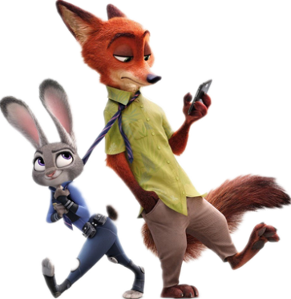
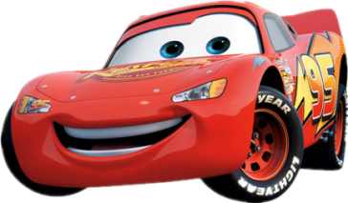
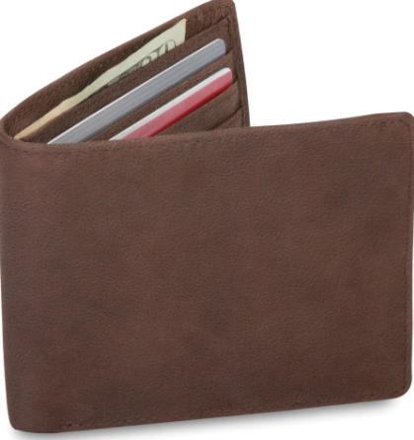
What is my favorite movie? A. Cars B. Zootopia
What is my favorite animal? A. Rabbits. B. Cats.
Which university did I visit this October? A. Princeton University (普林斯顿大学) B. Oxford University (牛津大学)
What did my student lose in this trip? A. A phone B. A wallet

Slide 4
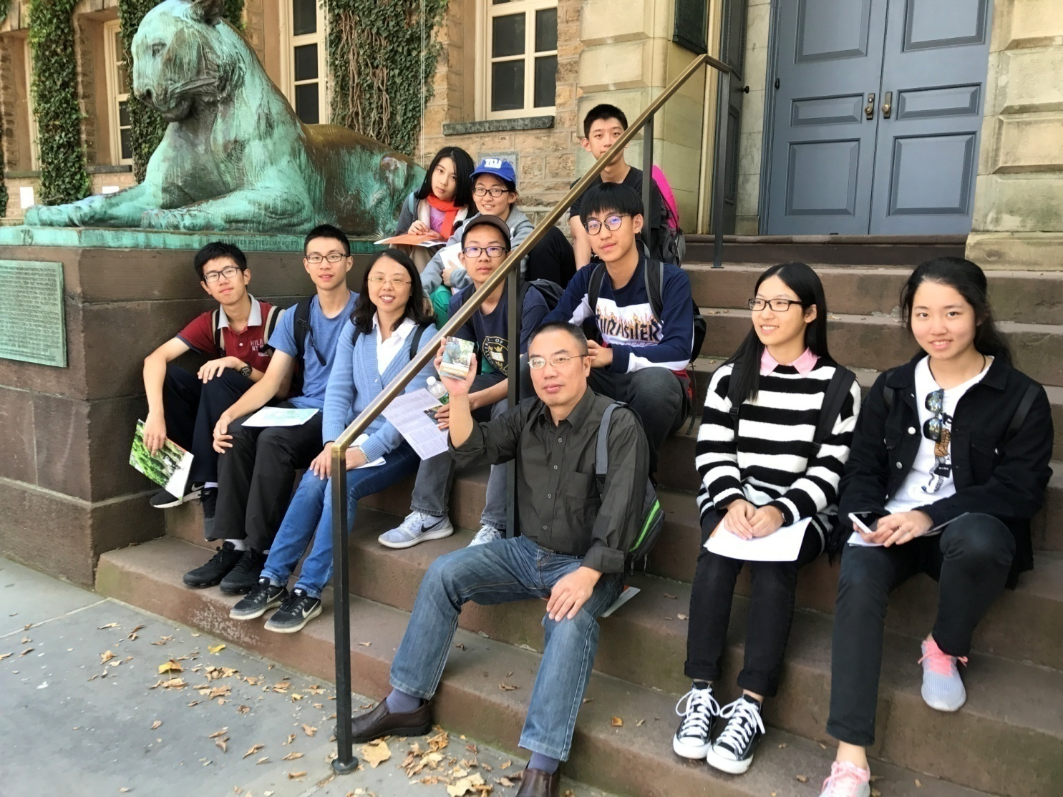

Slide 5
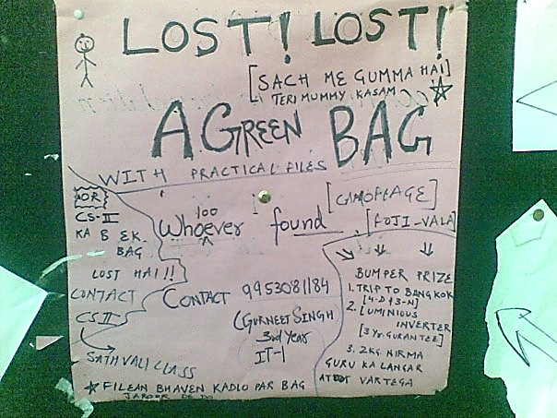
What can we do?
LOST

Slide 6
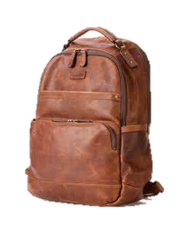
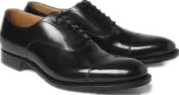
leather backpack
leather shoes

Slide 7
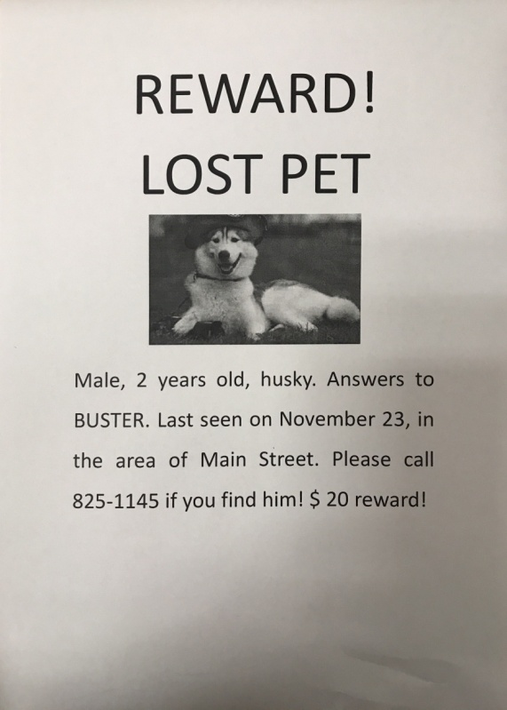
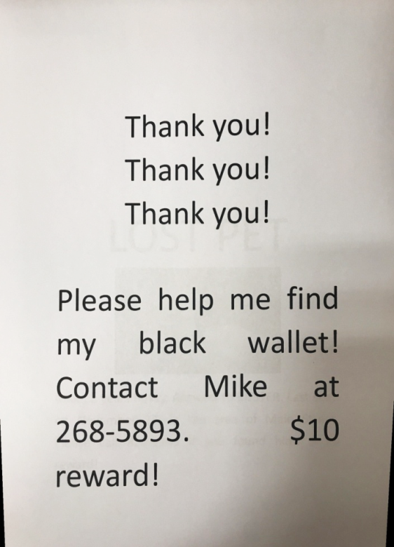
Compare

Slide 8
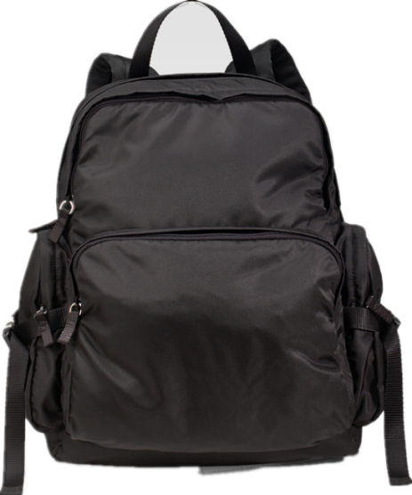
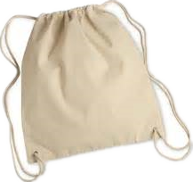
material
leather
cloth
nylon (尼龙)

Slide 9
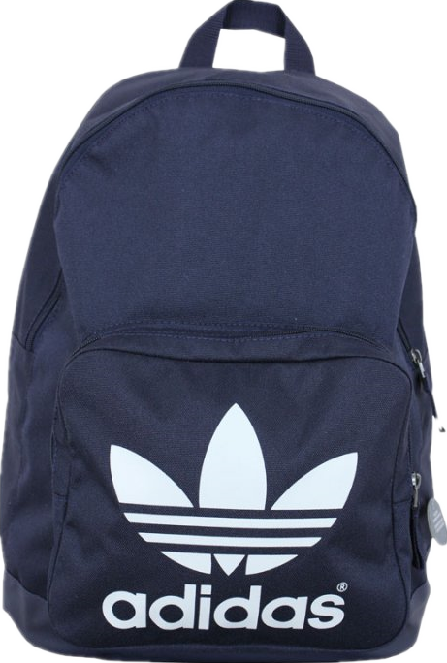
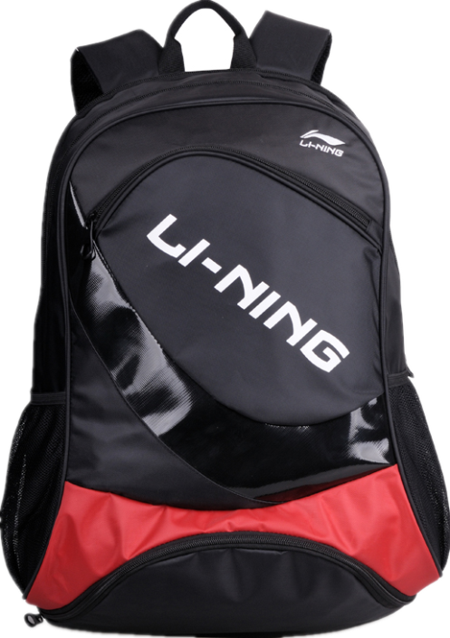
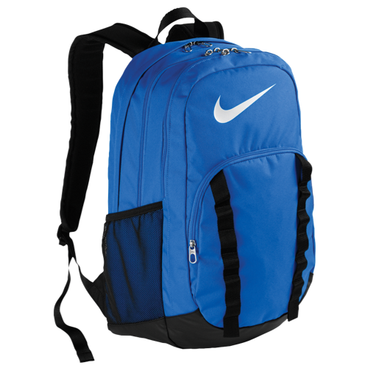
brand

Slide 10
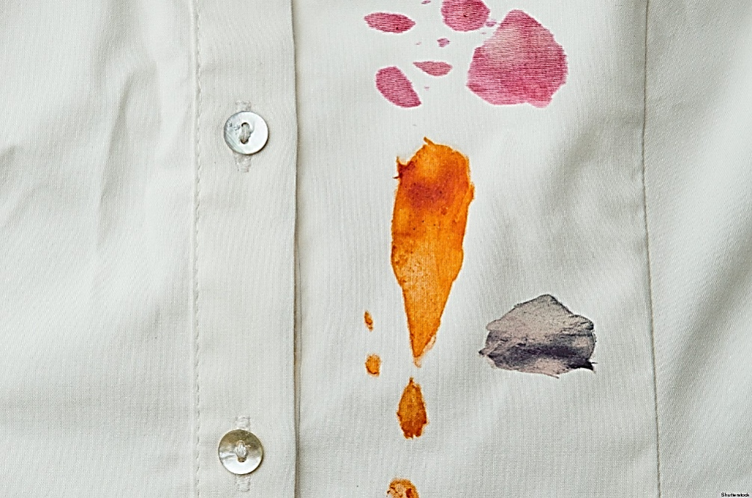
other features
personal information
stain on clothes

Slide 11
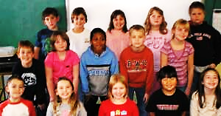
patience 耐心
confidence 信心
friendship
…

Slide 12
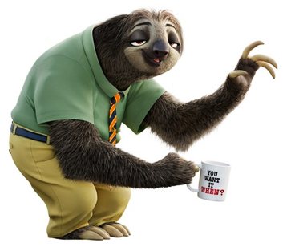
Write a lost notice.
LOST

Slide 13
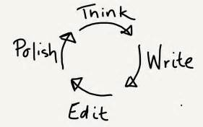
My partner’s writing
covers key elements. has detailed description. is brief and to the point. is eye-catching.

Slide 14
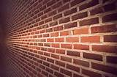
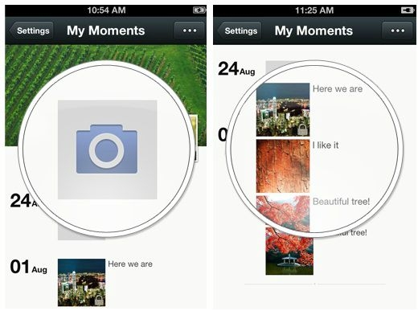
Where should we put the lost notice?

Slide 15
Homework
Revise and improve your writing, and email it to:
creativewriting123@163.com
G---O---O---D---B---Y---E~

