Slide 1
Unit 12 What did you do last weekend?
Writing

Slide 4
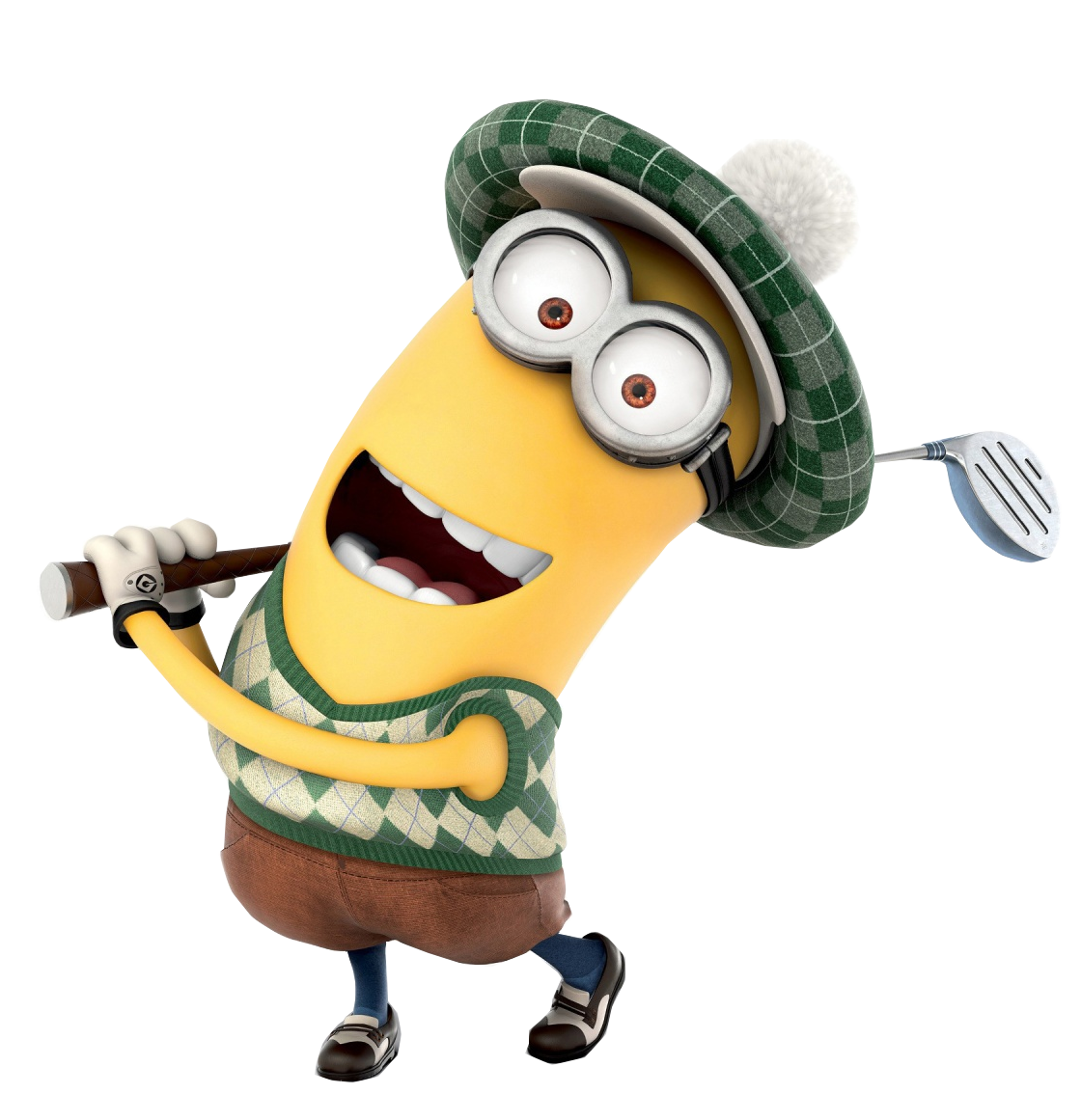
What did he do last weekend?

Slide 5
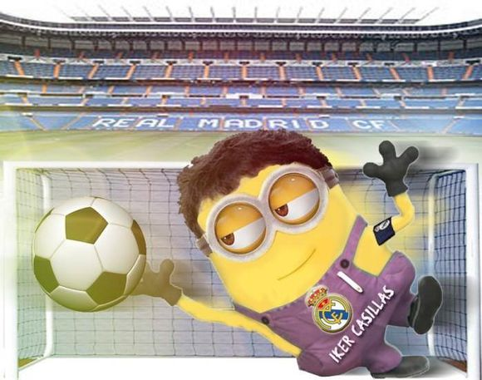
Last weekend, on Saturday morning…
I play football with my friends.
ed

Slide 6
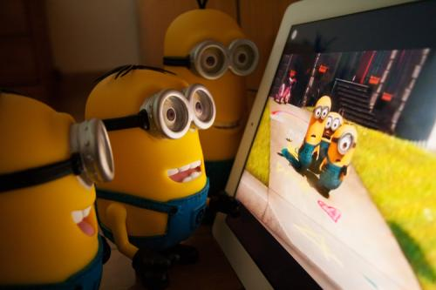
In the afternoon…
I watch a funny movie.
ed

Slide 7
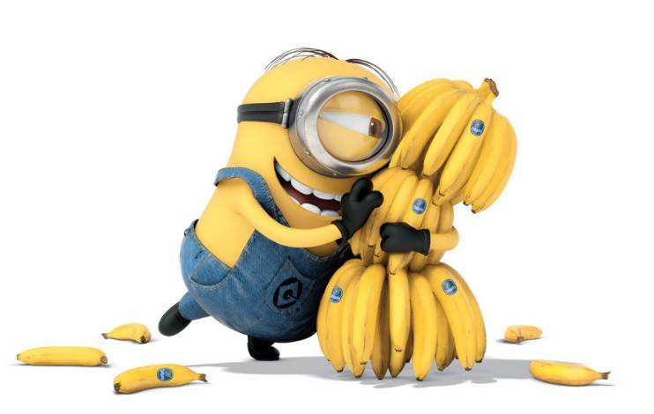
In the evening…
I delicious bananas.
ate
eat

Slide 8
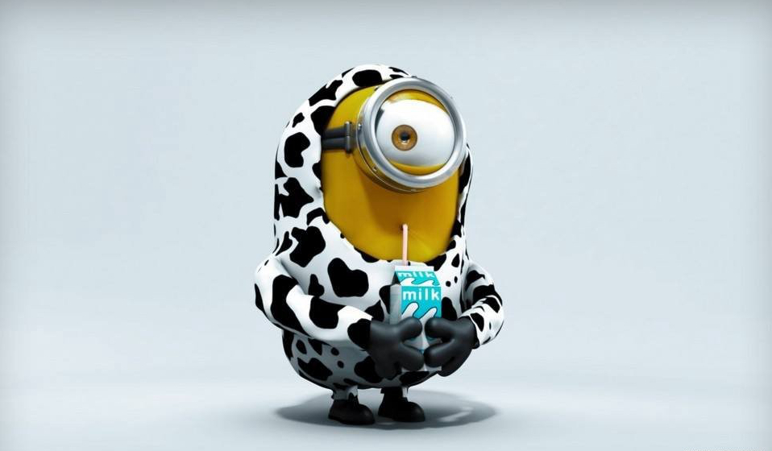
On Sunday morning…
drank
I some milk.
drink

Slide 9
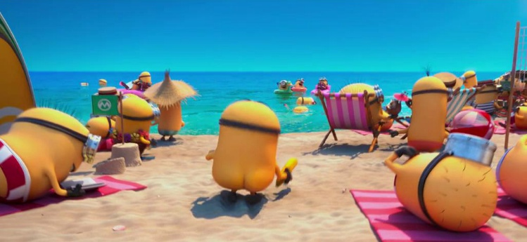
In the afternoon…
went
I to a beautiful beach.
go

Slide 10
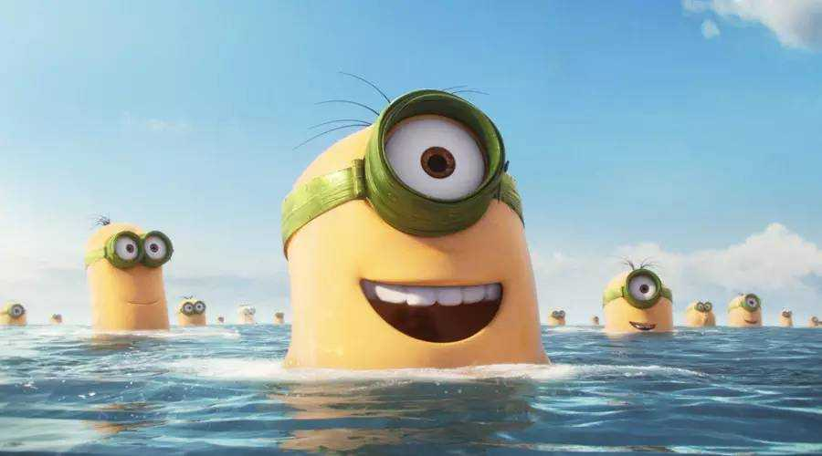
swim
I in the sea.
swam

Slide 11
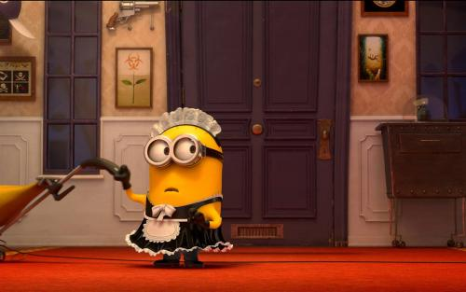
On Sunday evening…
I some housework.
did
do

Slide 12
What do you think of Bob’s weekend?
relaxing
boring

Slide 13
Game: Test of your memory

Slide 14
Dear Kevin,
I had a relaxing weekend. On Saturday morning, I
played football. In the afternoon, I watched a funny movie.
In the evening, I ate delicious bananas. On Sunday morning,
I drank some milk. In the afternoon, I went to the beautiful
In the evening, I did some housework.. What about you
and your friends’ weekends?
Bob

Slide 15
Task 1: Look at the pictures and fill in the blanks
Dear Kevin,
relaxing
I had a ___________ weekend. On Saturday morning, I _____________ with my friends. ___________________.
In the afternoon, I ______________. . In the evening, I _______________. . On Sunday morning, I _______________. _____________.
In the afternoon, I _____________ and _______________.
______________. In the evening, I _________________ . ___________. I _____ my weekend because ___________.
What about you and your friends’ weekends?
played football
watched a movie
ate some bananas
drank some milk
went to a beach
swam in the sea
did some housework
Bob

Slide 16
Dear Kevin,
Topic sentence
Feelings
I had a relaxing weekend.
On Saturday morning, I played football with my friends. We enjoyed ourselves. In the afternoon, I watched a movie. It was funny. In the evening, I ate some bananas. They were delicious. On Sunday morning, I drank some milk. It was good for my health. In the afternoon, I went to the beach and swam in the sea. I had a great time. In the evening, I did some housework. I felt glad to help my mom.
I love my weekend because it was relaxing. What about you and your friends’ weekends?
Time- line
Conclusive sentence
Bob

Slide 17
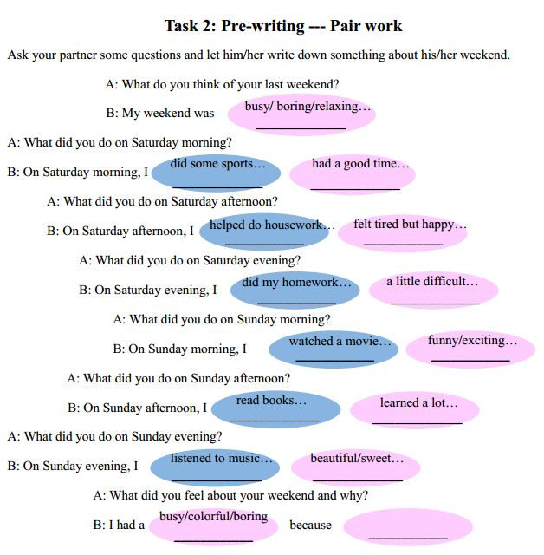

Slide 18
Task 3 Writing
Write a letter to Bob to tell him your weekend.
Try to write three parts.
Dear Bob,
____________________________________________________________
____________________________________________________________
____________________________________________________________
____________________________________________________________
____________________________________________________________
____________________________________________________________
____________________________________________________________
Yours,
______

Slide 19
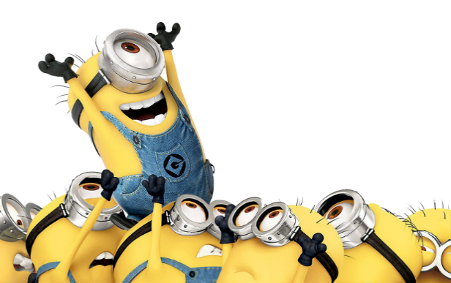
Task 4 Group work --- Finish the checklist
Read your partners’ letters and check.
There is a topic sentence in the letter.
There is a timeline in the letter.
There are feelings about the activities in the letter.
There is a conclusive sentence in the letter.
The letter uses past tense verbs properly.
(like “ watched , ate, played…)
There are no spelling mistakes or grammatical mistakes. （拼写或语法错误）

Slide 20
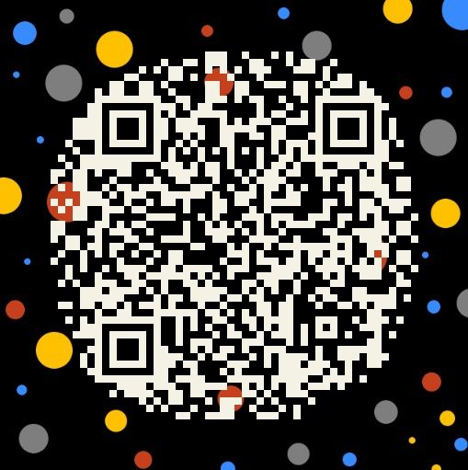
Homework
Read another three stories in your class , then choose the best one and tell us why.
Share your opinions on how to write a good story on WeChat.

Slide 21
THANK YOU!

