Slide 1
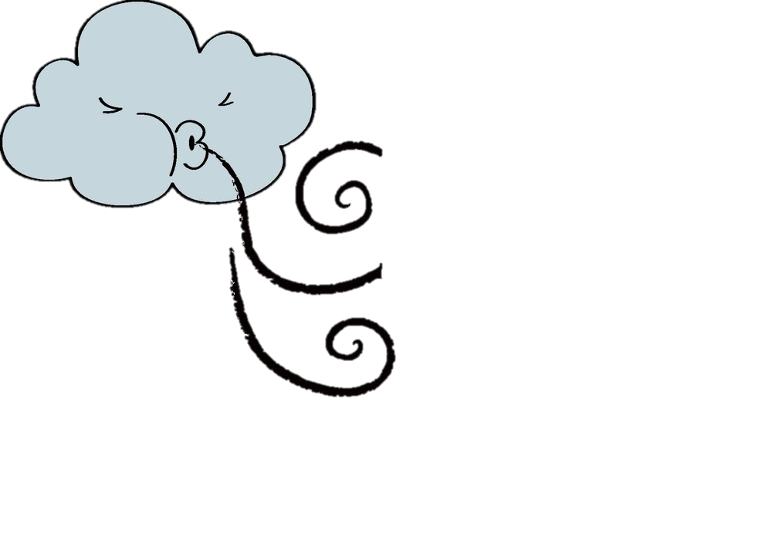
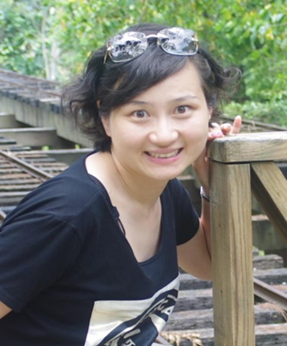
王颖婷老师英语功底扎实，在2017年上海市中学中青年教师教学评选活动中，获得中学英语学科一等奖。她的教学风格严谨又不乏生动幽默，上课深入浅出，条理清楚，能引导学生进行有效学习，激发学生的个性化思维，让学生主动参与课堂、乐于探究、勤于思考、学会合作来感受成功。

Slide 2
Welcome to my class
Welcome to my class

Slide 4
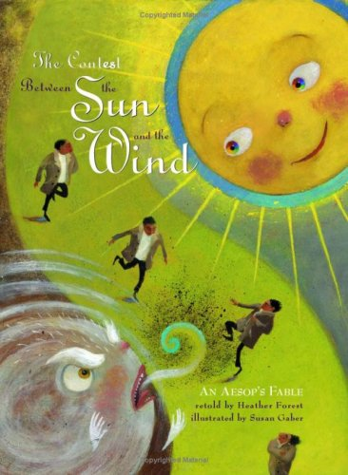
They are going to
have a c________________.
ompetition

Slide 5
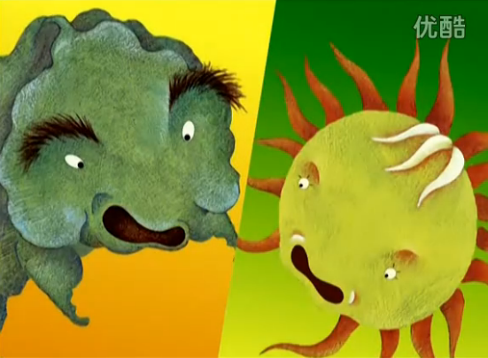
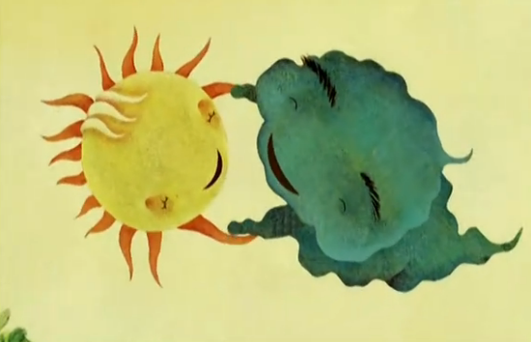
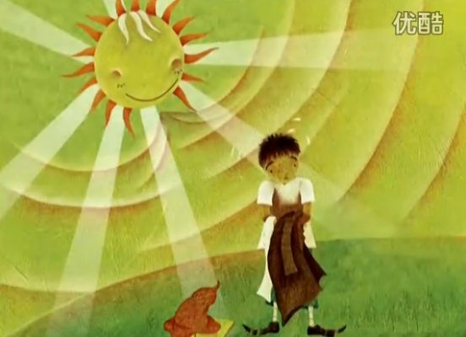
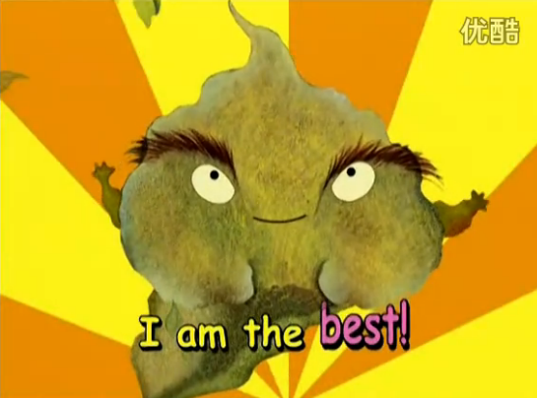
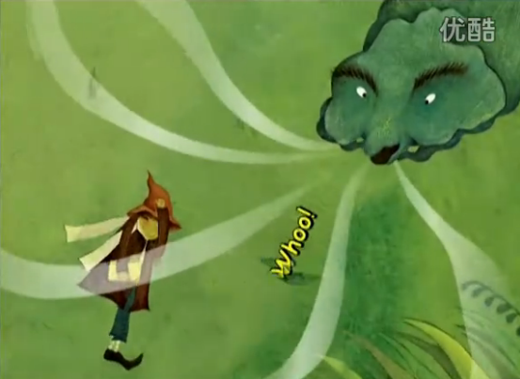
A
B
A
B
C
C
1. ________
2. ________
3. ________
4. ________
5. ________
D
E
D
E

Slide 6
‘Can you see that man over there? Let’s see who can get his coat off in the shortest time,’ said Mr Wind.
‘That’s a good idea. You go first,’ said Mr Sun.
A
A

Slide 7
‘Don’t feel sad,’ said Mr Sun. ‘Strength is not always important. I think we’re as strong as each other. I can make plants grow and you can push boats forward. Let’s be friends forever.’
‘I agree,’ said Mr Wind and he smiled.
B
B

Slide 8
‘Let me try,’ said Mr Sun. He shone brightly. Soon it became warmer and warmer. The man felt very hot and started sweating. He took off his coat. Mr Wind’s face became red again.
‘You win, Mr Sun,’ said Mr Wind sadly. ‘I’m not as strong as you.’
C
C

Slide 9
Mr Wind was very proud. He liked showing off his strength all the time. One day, Mr Wind met Mr Sun and said, ‘People always think that we’re as strong as each other. I think I’m stronger than you. Shall we have a competition?’
D
D

Slide 10
Mr Wind blew and blew. Soon his face became red. However, he still could not get the man’s coat off. Mr Wind became very angry and he began to blow hard. The man held his coat more tightly in the wind because he was cold. Mr Wind felt very tired and looked disappointed.
E
E

Slide 11
A
B
A
B
C
C
D
1. ________
2. ________
3. ________
4. ________
5. ________
A
E
C
B
D
E
D
E

Slide 12
1
Mr Wind was very proud. He liked showing off his strength all the time. One day, Mr Wind met Mr Sun and said, ‘People always think that we’re as strong as each other. I think I’m stronger than you. Shall we have a competition?’
Before the competition
2
‘Can you see that man over there? Let’s see who can get his coat off in the shortest time,’ said Mr Wind.
‘That’s a good idea. You go first,’ said Mr Sun.
3
Mr Wind blew and blew. Soon his face became red. However, he still could not get the man’s coat off. Mr Wind became very angry and he began to blow hard. The man held his coat more tightly in the wind because he was cold. Mr Wind felt very tired and looked disappointed.
During the competition
4
‘Let me try,’ said Mr Sun. He shone brightly. Soon it became warmer and warmer. The man felt very hot and started sweating. He took off his coat. Mr Wind’s face became red again.
‘You win, Mr Sun,’ said Mr Wind sadly. ‘I’m not as strong as you.’
5
‘Don’t feel sad,’ said Mr Sun. ‘Strength is not always important. I think we’re as strong as each other. I can make plants grow and you can push boats forward. Let’s be friends forever.’
‘I agree,’ said Mr Wind and he smiled.
After the competition

Slide 13
Mr Wind was very proud. He liked showing off his strength all the time. One day, Mr Wind met Mr Sun and said, ‘People always think that we’re as strong as each other. I think I’m stronger than you. Shall we have a competition?’
‘Can you see that man over there? Let’s see who can get his coat off in the shortest time,’ said Mr Wind.
‘That’s a good idea. You go first,’ said Mr Sun.

Slide 14
What did Mr Wind like doing all the time?
Why did Mr Wind want to have a competition?
Why did Mr Wind say 'Let's see who can get the man's coat off in the shortest time’?
Why did Mr Sun say ‘You go first.’?

Slide 15
Mr Wind blew and blew. Soon his face became red. However, he still could not get the man’s coat off. Mr Wind became very angry and he began to blow hard. The man held his coat more tightly in the wind because he was cold. Mr Wind felt very tired and looked disappointed.
design (设计)questions
Who ...?
What ...?
When ...?
Where ...?
How ...?
Why ...?

Slide 16
‘Let me try,’ said Mr Sun. He shone brightly. Soon it became warmer and warmer. The man felt very hot and started sweating. He took off his coat. Mr Wind’s face became red again.
‘You win, Mr Sun,’ said Mr Wind sadly. ‘I’m not as strong as you.’
‘Don’t feel sad,’ said Mr Sun. ‘Strength is not always important. I think we’re as strong as each other. I can make plants grow and you can push boats forward. Let’s be friends forever.’
‘I agree,’ said Mr Wind and he smiled.

Slide 17
 | People always think that we’re as strong as each other. I think I’m stronger than you. Shall we have a competition? Hah hah hah..
 | Can you see that man over there? Let’s see who can get his coat off in the shortest time.
 | That’s a good idea. You go first.
 | Let me try.
 | You win, Mr Sun. I’m not as strong as you.
 | Don’t feel sad. Strength is not always important. I think we’re as strong as each other. I can make plants grow and you can push boats forward. Let’s be friends forever.

Slide 18
What have you learnt?

Slide 19
Homework
Read the story again in proper tones to show the personalities and feelings of the characters.
Read one more fable and prepare to share with each other in class.
Suggested website:
http://www.aesops-fables.com/

Slide 20
Thanks
Thanks

