Slide 1
Vacation Experience
Read
Think
Du Yingni, Jiangxi

Slide 2
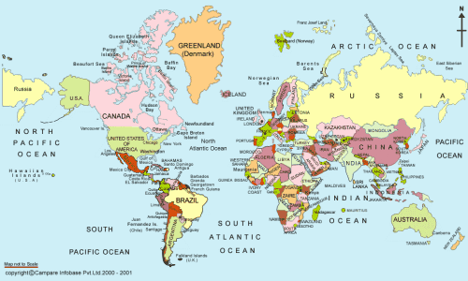
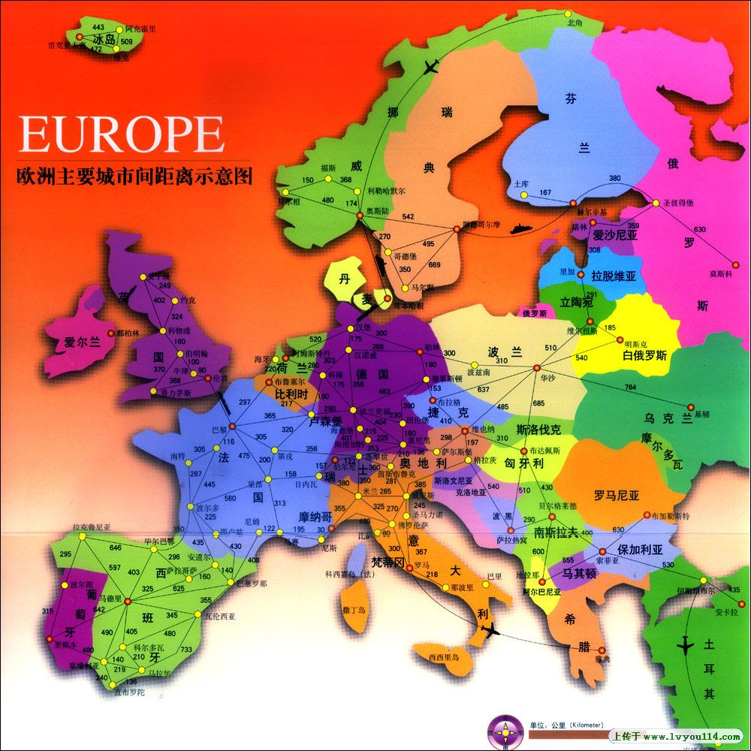

Slide 3
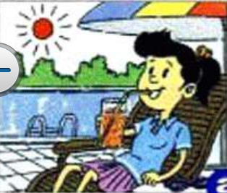
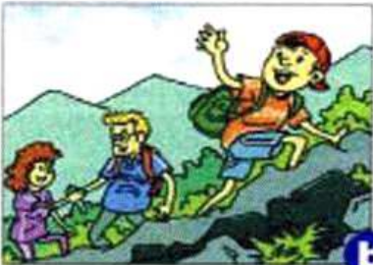
Watch and say.
b
c
a

Slide 4
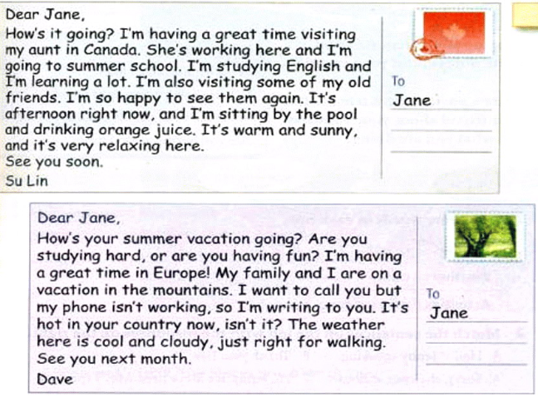
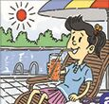
Match and circle the reasons.
a
b
c

Slide 5
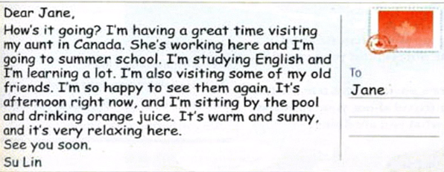
Read and underline the answers.
1
What else is Su Lin doing?
2
Where is she?
3
How does she feel?

Slide 6
Finish the mind map.
Dave’s holiday
Place
Activities
people
Feelings
Weather
in Europe,
in the mountains
writing a postcard,
climbing mountains
his
parents
have
a
great
time
cool and cloudy
...
...
...
...
...

Slide 7
Speak like a foreigner

Slide 8
Retell
Su Lin’s and
Dave’s holiday
experiences
place
people
weather
activities
feelings

Slide 9
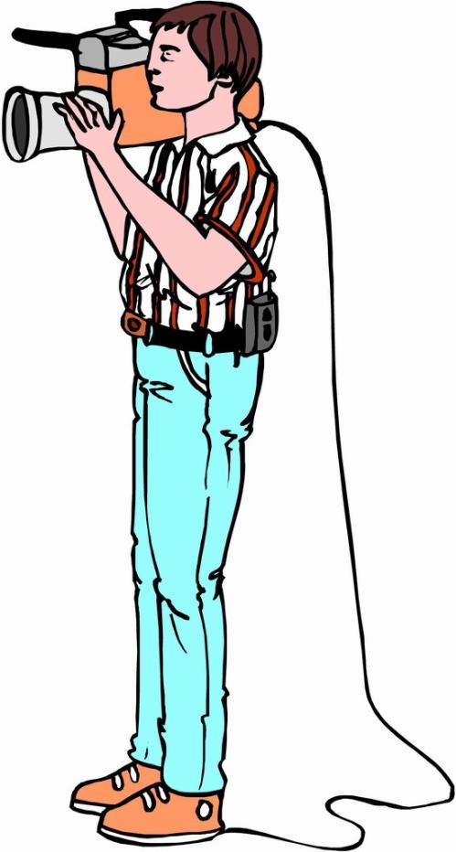
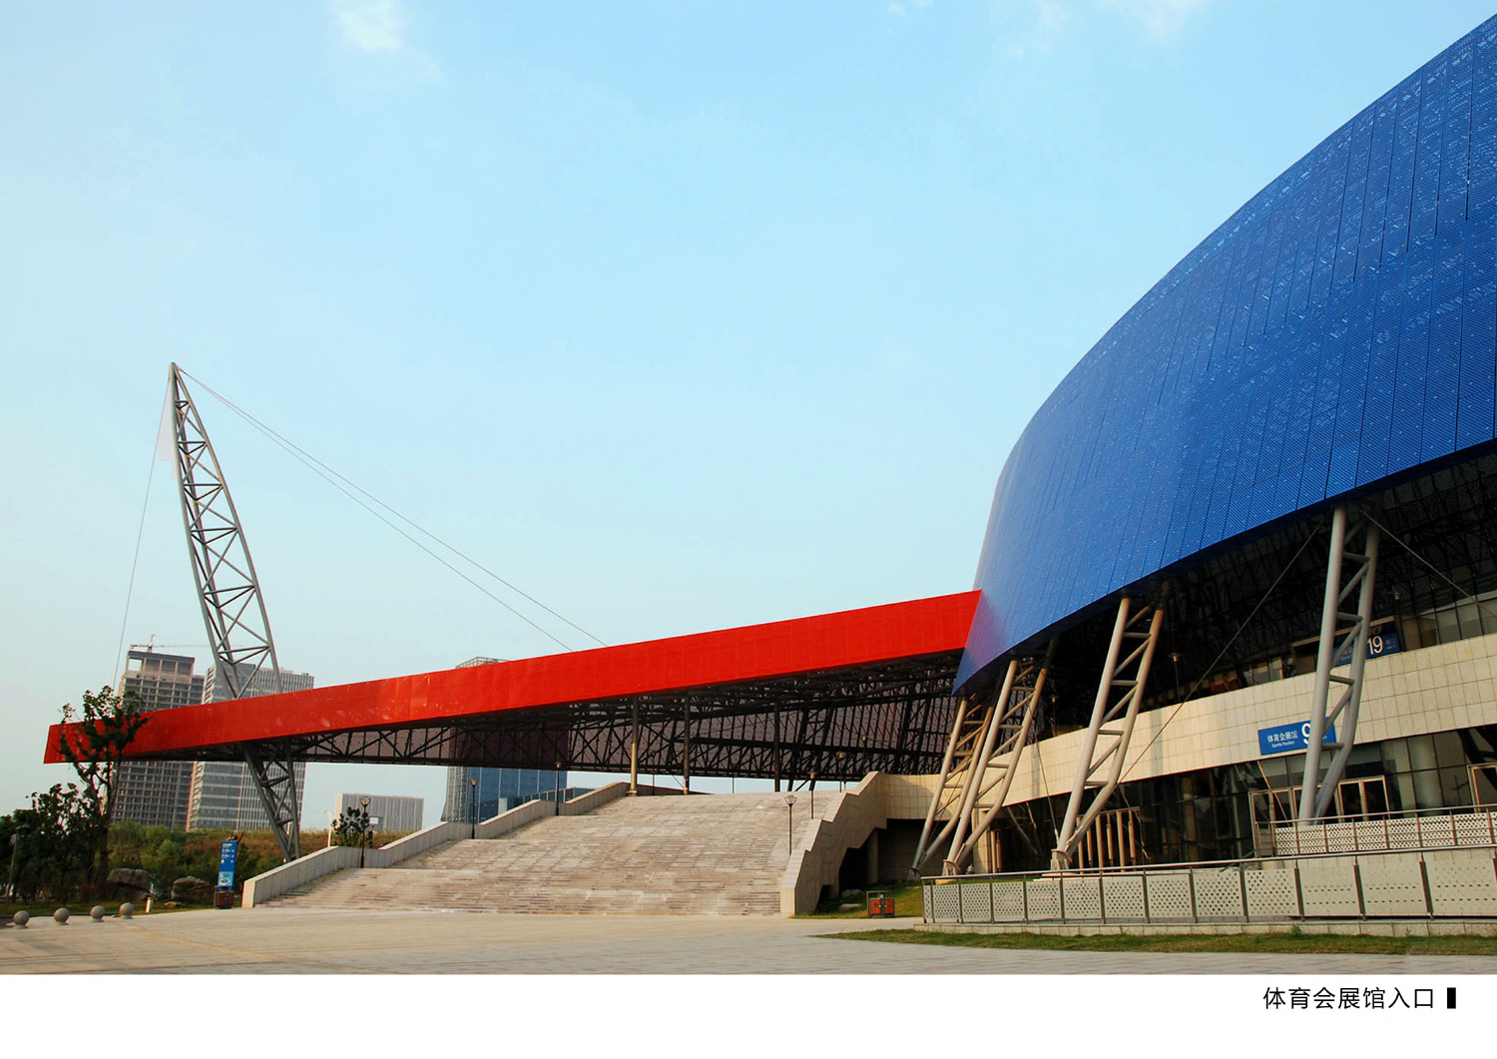
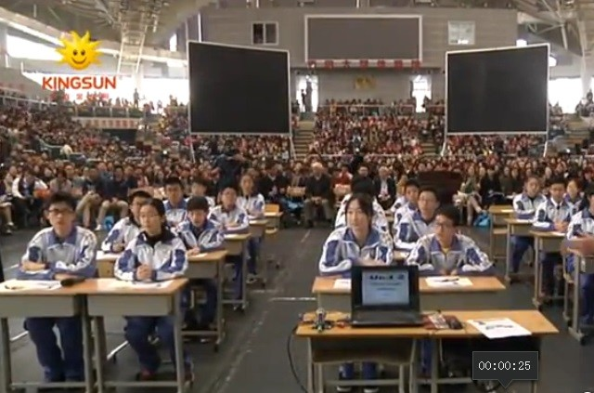
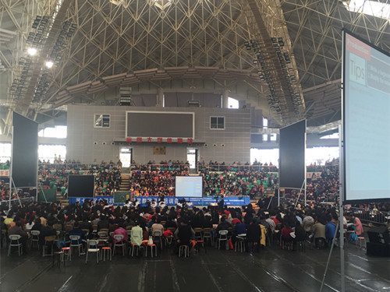
Share our experience on the postcard.
To
_____________
After reading,I know:
★place, time,people,weather
★activities,true feelings…
★clear and neat handwriting
★ interesting and beautiful sentences
...
Dear_______,
How's it going?Today is not like any other day,
I’m having a good …
Good luck!
____________

Slide 10
How foreign students spend their vacation:

Slide 11
What do you think of yourself and your classmates?
学习 环节 | 评价内容 | 完成情况
准备 | 我能主动跟着老师设计的活动学习，主动思考、预测并落落大方的回答老师提出的问题。 | A. 很容易 | B. 较容易 | C. 有困难
阅读 | 我能通过仔细观察图片和阅读看懂、理解明信片内容；并制作思维导图，能积极思考假期里不同天气下有意义的活动和写明信片的意义；同学有需要时互相帮助。 | A. 很容易 | B. 较容易 | C. 有困难
内化 | 归纳总结明信片格式 | A. 很容易 | B. 较容易 | C. 有困难
写作 | 充分发挥想象力在明信片上描述自己理想的假期活动或者现场上课纪实，运用正确的格式、时态，要点齐全，语言流畅有条理，表达自己的真实想法。 | A. 很容易 | B. 较容易 | C. 有困难
总体评价 | 1.我是否全身心投入学习？课上有没有跟不上老师的情况？原因是什么？如何改进？ 2.和其他同学比我的优点有哪些？不足之处在哪？向其他同学学习借鉴的地方在哪？课上哪些方法对自己学习帮助最大？

Slide 12
After this class:
1.Polish your writing after this class with peer checklist.
2.Scan the QR code and watch a micro video:

