Slide 1
Reading Class
For Junior 2
合肥世界外国语学校 王冠博

Slide 3
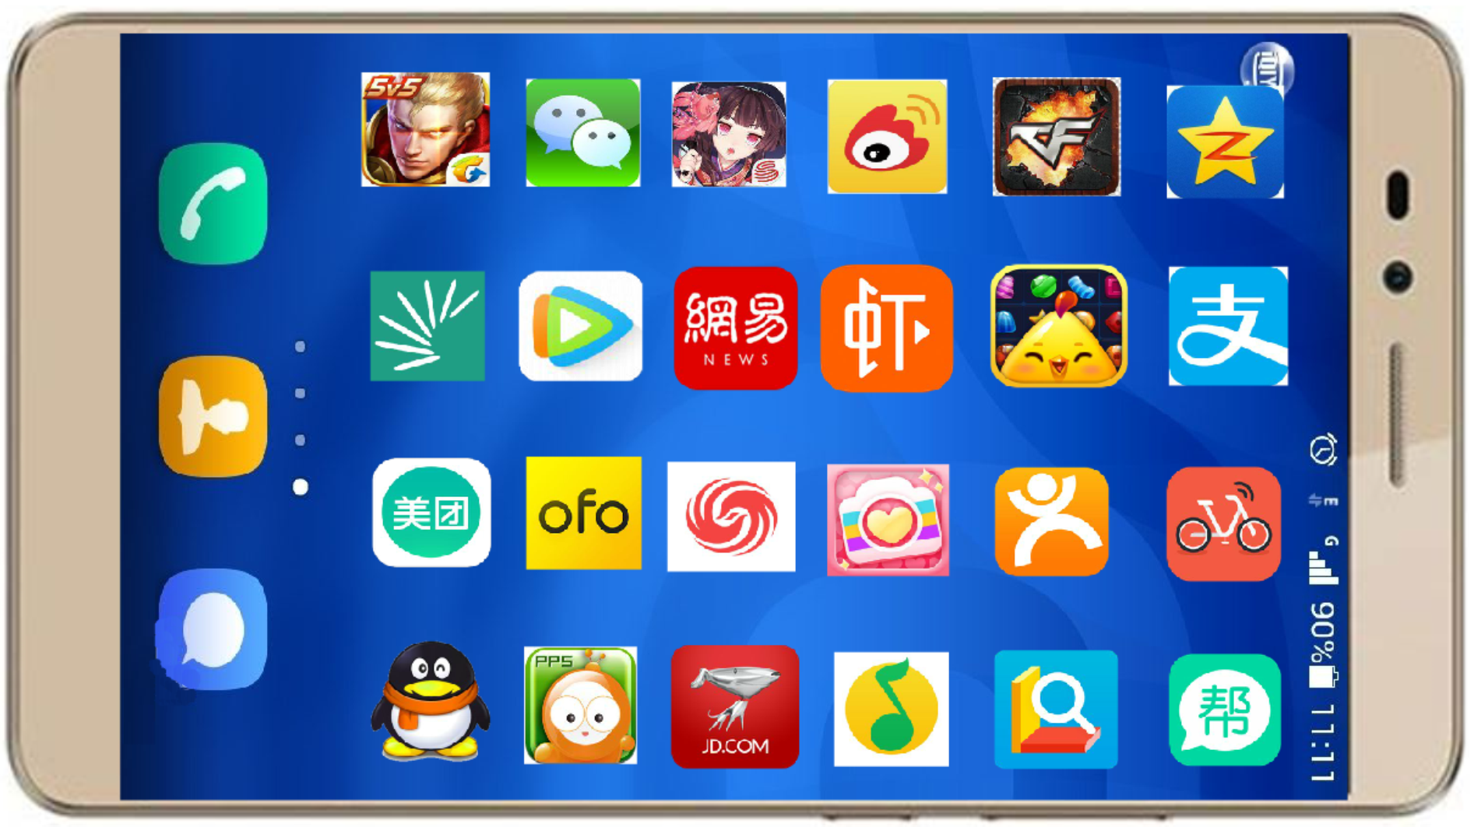
smartphone

Slide 4
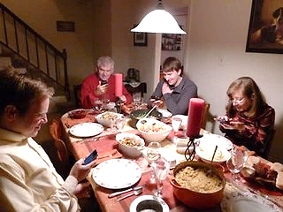
face-to-face
communication
addiction

Slide 5
Read and classify
Read to find out the 2 sides of using smartphones
harmful
smart

Slide 6
To remember 11 numbers is not difficult, but because of the smartphone, many of us cannot remember them.
Moreover, smartphones weaken our skills at giving directions. We cannot tell the north and the south. Smartphones also kill face-to-face communications, for example, people don’t talk to each other even when they have a meal together. It’s common for people to check their phones during the meal.
In addition, for students, an addiction to smartphones does no good for studying. Research showed children who play more than four hours a day with their phones perform much worse than children who play with their phones for less than 30 minutes.
However, smartphones have many advantages as well. People can use their phones to surf the Internet and get news quickly. Smartphones open people’s eyes and make our lives easier.

Slide 7
1.
If you need to call your parents but your phone is not with you, can you remember their numbers?
2.
To remember 11 numbers is not difficult, but because of the smartphone, many of us cannot remember them.
3.
Moreover,
smartphones weaken our skills at giving directions. We cannot tell the north and the south. Smartphones also kill face-to-face communications, for example, people don’t talk to each other even when they have a meal together. It’s common for people to check their phones during the meal.
Harmful
Body（2 sides）
In addition,
4.
for students, an addiction to smartphones does no good for studying. Research showed children who play more than four hours a day with their phones perform much worse than children who play with their phones for less than 30 minutes.
However,
5.
smartphones have many advantages as well. People can use their phones to surf the Internet and get news quickly. Smartphones open people’s eyes and make our lives easier.
Smart
6.
It’s true the smartphone causes some problems, but it is still one of the best inventions of the century. People just spend too much time on it. It’s very important for us to make a change.

Slide 8
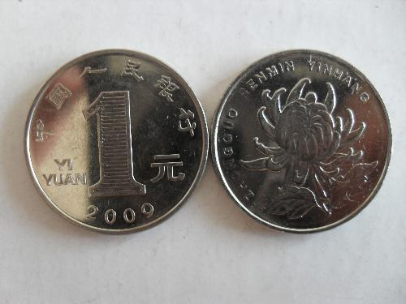
Each coin has two sides!

Slide 9
Beginning
1.
If you need to call your parents but your phone is not with you, can you remember their numbers?
2.
To remember 11 numbers is not difficult, but because of the smartphone, many of us cannot remember them.
3.
Moreover,
smartphones weaken our skills at giving directions. We cannot tell the north and the south. Smartphones also kill face-to-face communications, for example, people don’t talk to each other even when they have a meal together. It’s common for people to check their phones during the meal.
Body（2 sides）
In addition,
4.
for students, an addiction to smartphones does no good for studying. Research showed children who play more than four hours a day with their phones perform much worse than children who play with their phones for less than 30 minutes.
However,
5.
smartphones have many advantages as well. People can use their phones to surf the Internet and get news quickly. Smartphones open people’s eyes and make our lives easier.
6.
It’s true the smartphone causes some problems, but it is still one of the best inventions of the century. People just spend too much time on it. It’s very important for us to make a change.
Ending

Slide 10
Read and identify
Beginning
1.
If you need to call your parents but your phone is not with you, can you remember their numbers?
Read to find out the writer’s opinion:
2.
To remember 11 numbers is not difficult, but because of the smartphone, many of us cannot remember them.
It’s true the smartphone causes some problems, but it is still one of the best inventions of the century. People just spend too much time on it. It’s very important for us to make a change.
3.
Moreover,
, smartphones weaken our skills at giving directions. We cannot tell the north and the south. Smartphones also kill face-to-face communications, for example, people don’t talk to each other even when they have a meal together. It’s common for people to check their phones during the meal.
Body（2 sides）
In addition,
4.
for students, an addiction to smartphones does no good for studying. Research showed children who play more than four hours a day with their phones perform much worse than children who play with their phones for less than 30 minutes.
5.
smartphones have many advantages as well. People can use their phones to surf the Internet and get news quickly. Smartphones open people’s eyes and make our lives easier.
However,
6.
Ending
It’s true the smartphone causes some problems, but it is still one of the best inventions of the century. People just spend too much time on it. It’s very important for us to make a change.

Slide 11
Read and identify
Read to find out the writer’s opinion:
?
causes some problems,
It’s true the smartphone but it is still one of the best inventions of the century. People just on it. It’s very important for us to
spend too much time
make a change.
It’s true . . . , but . . .
transition
agree with the other side
write down your opinion
(harmful)
(smart)

Slide 12
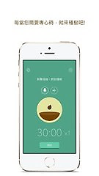
Read and answer
Who helps us make a change?
How do they help us make a change?
After planting a tree in the app, people cannot use their phones, or the tree will die.
right way
spend less time
The restaurant in USA gives people
discount if they don’t check their phones during a meal.

Slide 13
Homework: Write a passage
How to use the smartphone in a right way?
(Make a change of the harmful sides)
It’s true…, but… . It’s very important for us to make a change.
For example, ……

Slide 14
What did we learn?
smart
harmful
All things have two sides
Make a change

