Slide 1
陆洋
山东省青岛第四中学
2017年第十二届全国初中英语优质课山东省预选活动第一名。

Slide 2
外研社版 悦读联播 美文精选
八年级上册
Words
which deceive
陆洋
山东省青岛第四中学

Slide 3
Truth!
A Lie!
I Don’t Know!

Slide 4
“If you do well, I will buy you a big meal!”

Slide 5
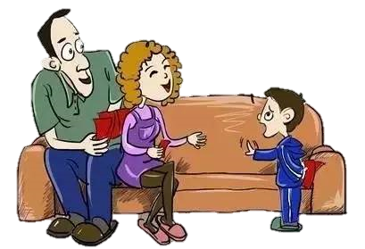
“Let me help you save your lucky money!”

Slide 6
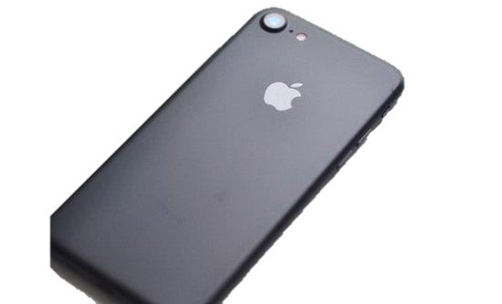
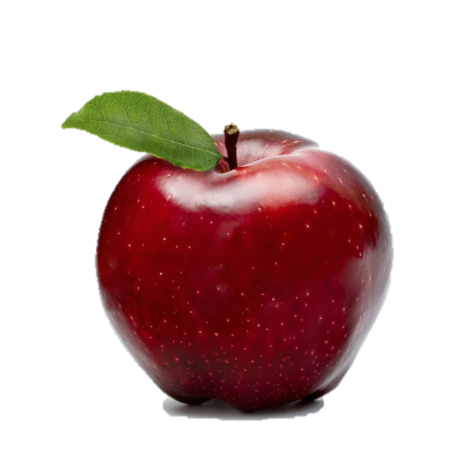
“Buy ONE, get ONE FREE!!!”
苹果

Slide 7
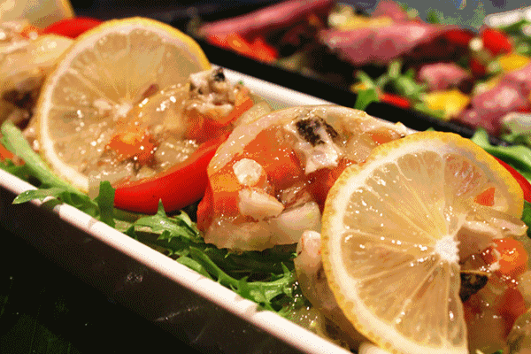
“…buy you…”
“…help you…”
“…free…”
Words
deceive
/dɪ'siːv/

Slide 8
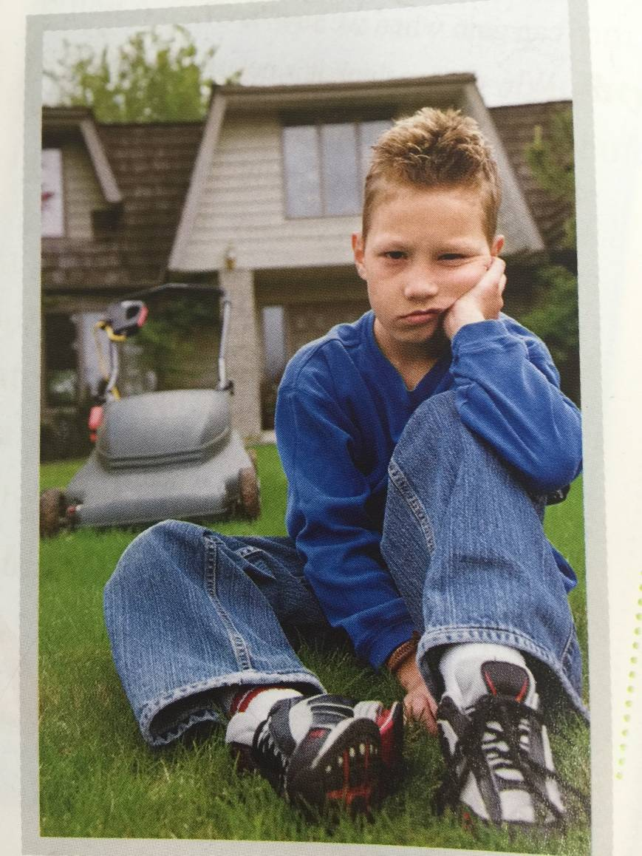
Tip: Focus on “…” while skimming.
Words
which deceive
What
happened?
made mistakes
Ned
deceived people
said sorry
Notes:
结合文章的照片
课文简介：
1. 由图读出人物
2. 由速读读出事件大概

Slide 9
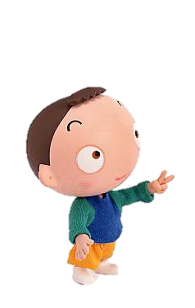
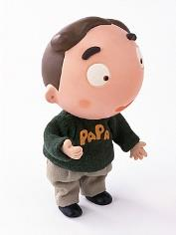
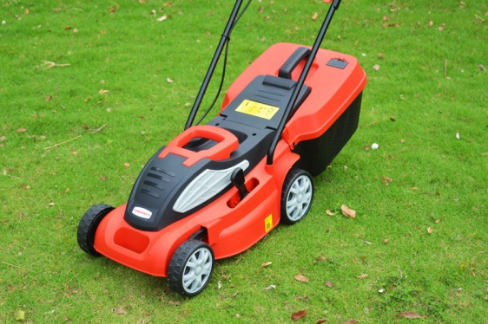
Beginning
What
Ned broke
the mower.
Read Para.1
was the mistake?
mower
/ 'məʊə(r) /
angry

Slide 10
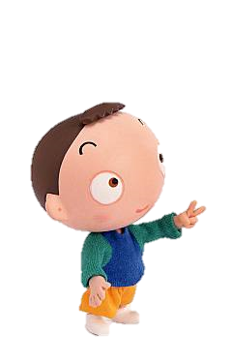
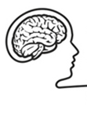
Ned broke
the mower.
?
Read Para.2
What did Ned say to himself?
Why did Ned say those words?
What did Ned do after school?

Slide 11
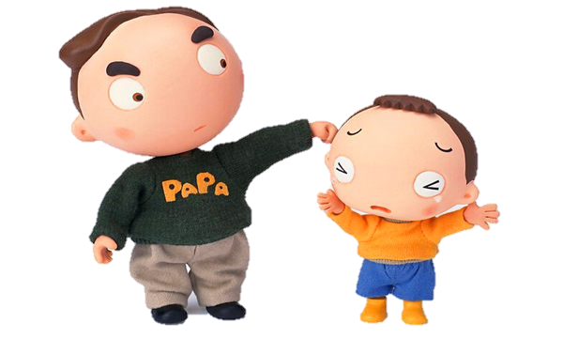
“I did not break the mower. It broke itself.”
He walked
through the park
slowly
slowly
alone.
alone.

Slide 12
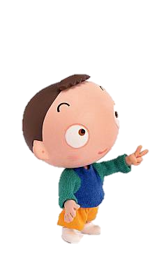
Ned broke
the mower.
Ned deceived himself.
?
Read Para.3-9
angry
afraid
？

Slide 13
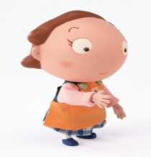
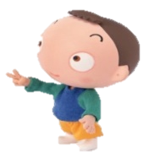
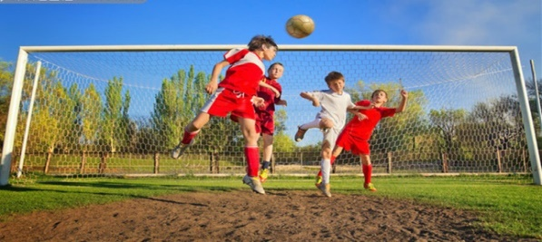
╳ 1
What did Ned say to his mother?
What didn’t Ned say to his mother?
“Where have you been, my boy?”
“When I play ball…”
“…I didn’t say I was playing…”

Slide 14
╳ 2
What did Ned say to himself?
What was the voice in Ned’s heart?

Slide 15
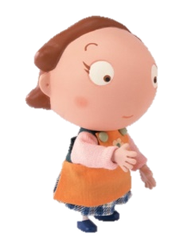
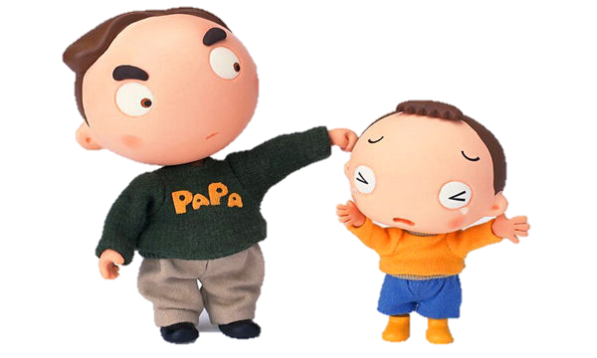
╳ 3
Why didn’t Ned tell the truth?
angry
afraid
…

Slide 16
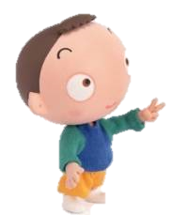
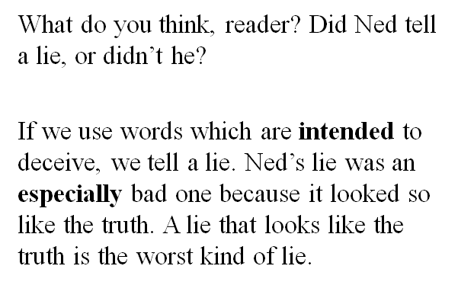
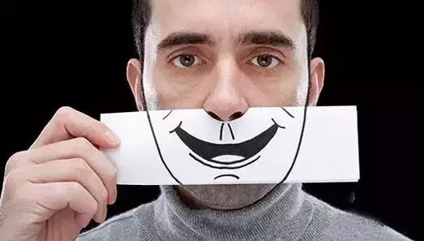
Ned’s story
Writer’s opinion
What is a lie?
What is the worst kind of lie?

Slide 17
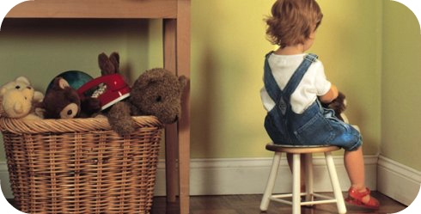
Think-and-share
Was Ned a really bad boy? Why or why not?
What did you learn from Ned’s story?
Notes:
T: The story ends but there are a lot more things for us to think about and share.

Slide 18
To be continued…

Slide 19
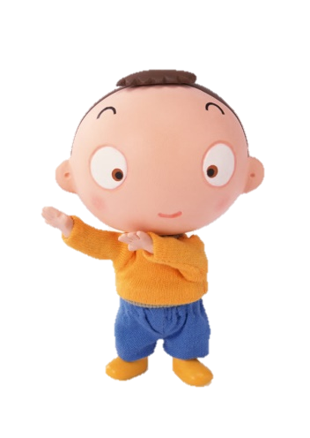
What
Why
How

Slide 21
花言巧语
Words
which deceive
A lie that looks like the truth
is the worst kind of lie.

Slide 22
Be honest!

Slide 23
Homework
Create an ending of the story and write it down.(For all)
Collect sayings and stories on honesty. (Optional)

