Slide 1
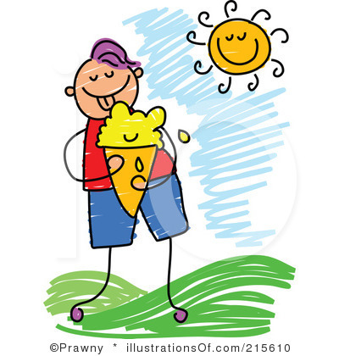
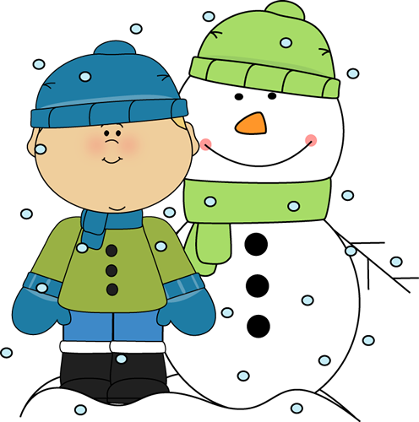
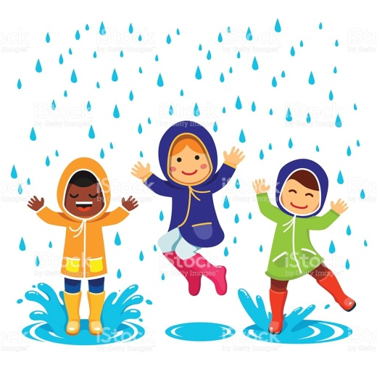
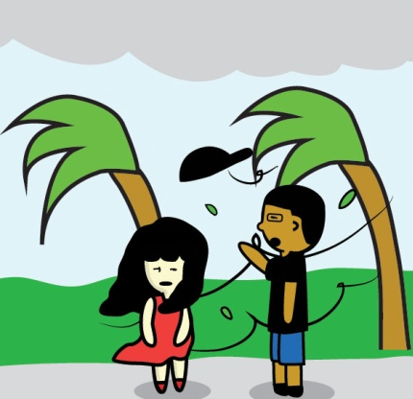
Change with weather
厦门外国语学校 刘洁昕

Slide 2
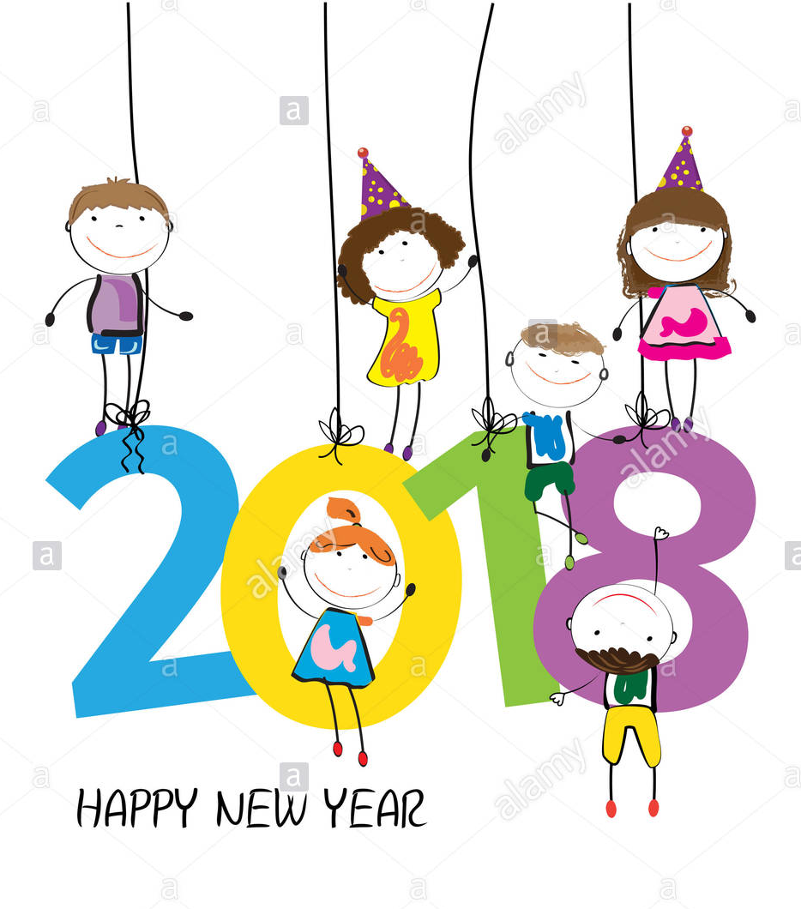
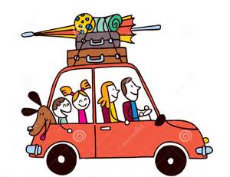
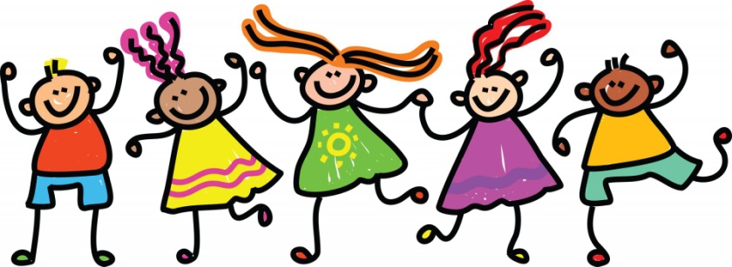
New Year Holiday

Slide 3
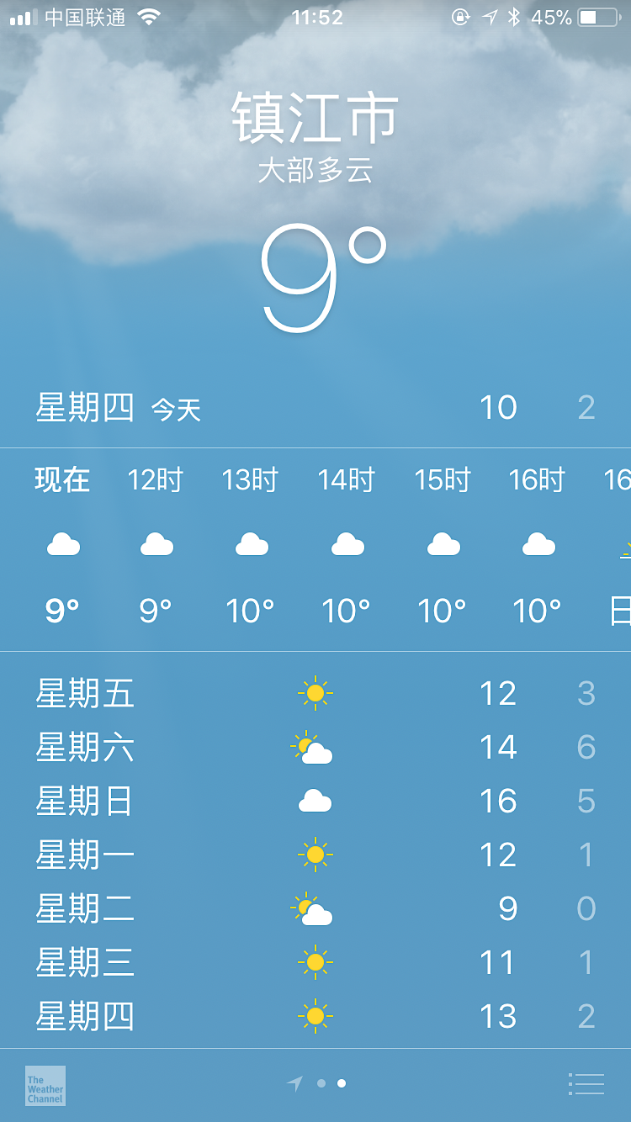
Let’s plan the holiday!!!
Weather
Activities

Slide 4
weather symbols
sunny
windy
cloudy
rainy
snowy

Slide 5
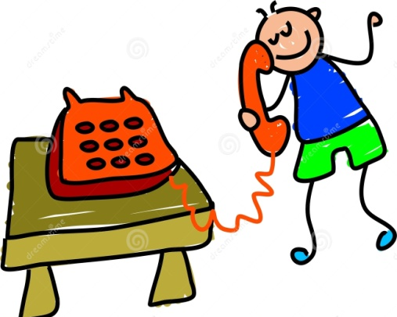
Match the places with the pictures.
Beijing
Moscow
Toronto
Boston
Shanghai
sunny
snowy
rainy
windy
cloudy

Slide 6
Know more about Beijing
Q : How’s the weather in Beijing?
What do people wear there ?
What kind of food do they have?
What do people do there?

Slide 7
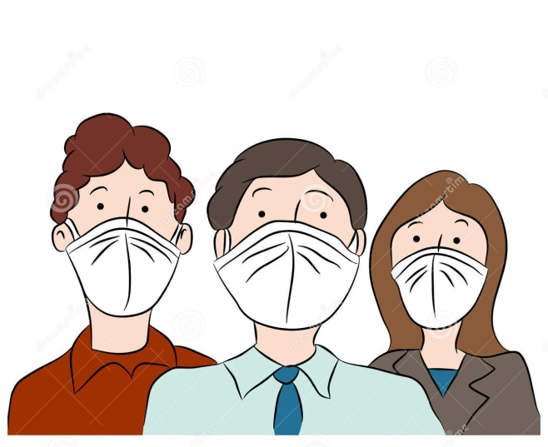
smoggy
smoggy
It’s __________.
masks
People wear ______.
do sports
We can’t __________.
Q : How’s the weather in Beijing?
What do people wear there ?
What do people do there?

Slide 8
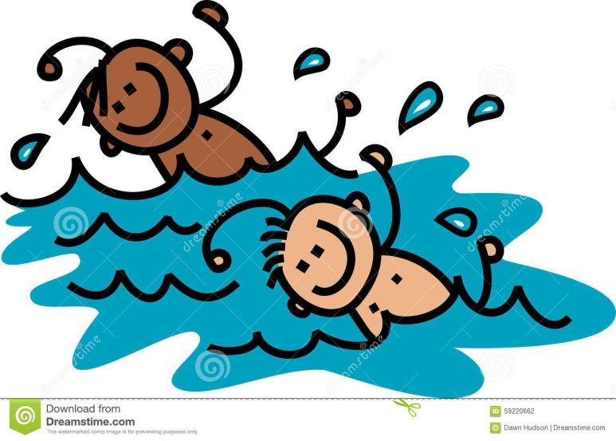
hot/sunny
It’s __________.
It’s __________.
a fine day
Boston
Q : How’s the weather in … ?
What do people do there?
… …

Slide 9
snowy
It’s _______.
It __________.
snows
Moscow
hats and scarves
People wear ______________.
build a snowman
People can ______________.
Q : How’s the weather in … ?
What do people …?
… …

Slide 10
rainy
It’s _______.
It __________.
rains
Toronto
raincoats
People wear _________.
dance in the rain
We can ________________.
Q : How’s the weather in … ?
What do people …?
… …

Slide 11
The weather there is _______.
Listen and fill in the blanks.
great
Name | Activity （What’s he doing?）
Steve
Rick’s brother
He is playing with some friends
at the park.
He is studying at his friends’ home.

Slide 12
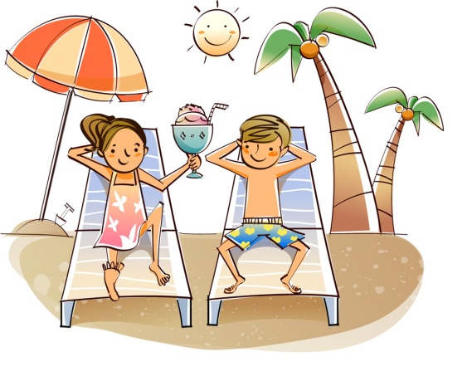
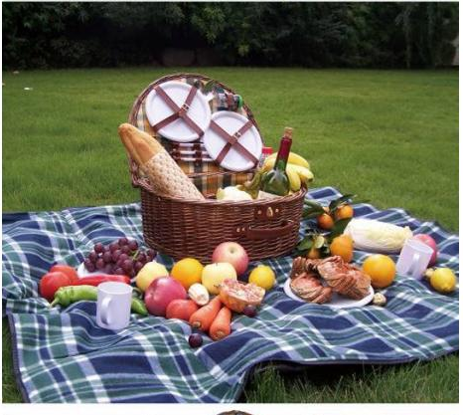
Activities for different weather
Q: What are you doing?
A: I am /We are doing …
have a sunbath
have a picnic

Slide 13
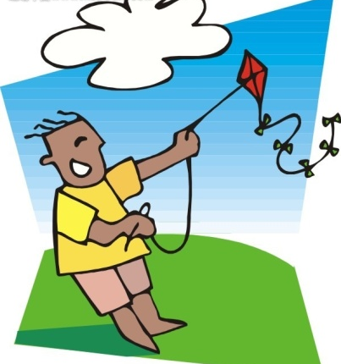
Activities for different weather

Slide 14
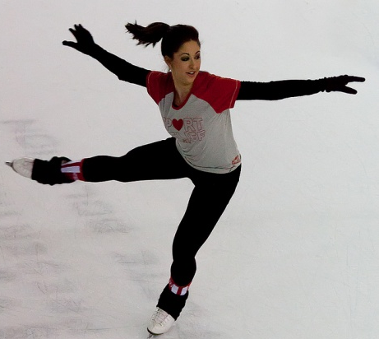
Activities for different weather
go skiing
go skating

Slide 15
Guessing game
weather symbols
activities

Slide 16
Questions you can ask:
How ‘s the weather?/What’s the weather like?
What are you doing?
How do you feel?
Is it sunny?
…
Are you playing football?
…
Are you happy?
Guess!

Slide 17
Reports on New Year’s Day
I am a reporter!

Slide 18
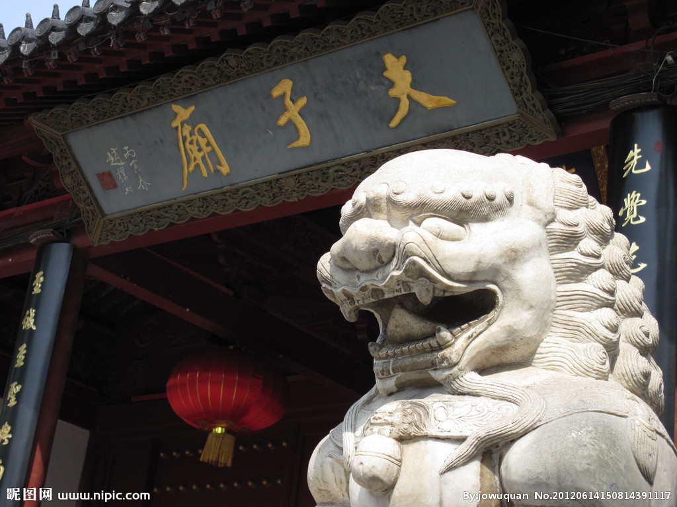
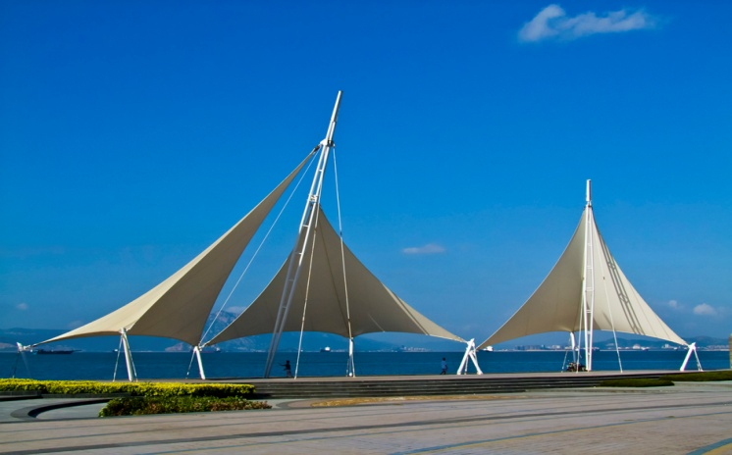
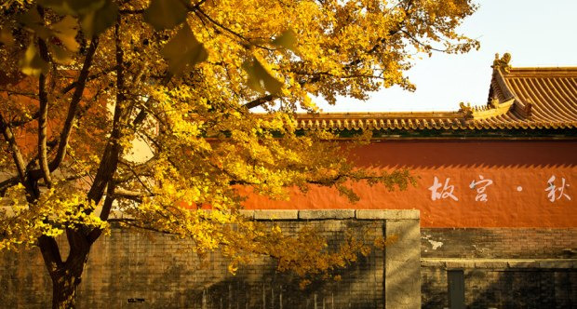
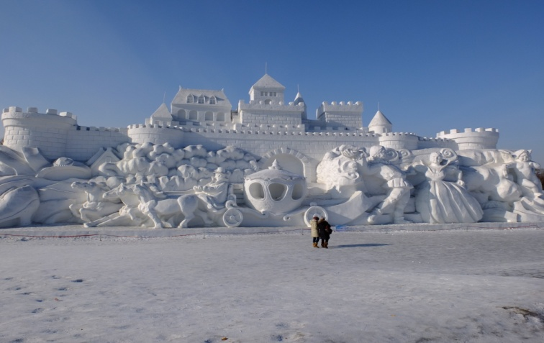
Group work
1. Choose a weather symbol in my box.
2. Choose a city to have your holiday.
3. Plan your activities.
Nanjing
Xiamen
Beijing
Ha’erbin

Slide 19
Group work
Student A ------ Reporter
Student B
Student C
Student D
….
---- Act the activities and answer questions.

Slide 20
Interview
I’m a reporter from CCTV.
Today is New Year’s Day .
I am in Zhenjiang. (place)
Questions:
How’s the weather?
What are you doing?
How do feel?
Are you happy/relaxed?
…
Thank you. That’s all for my report!
Happy New Year!
I am a reporter!

Slide 21
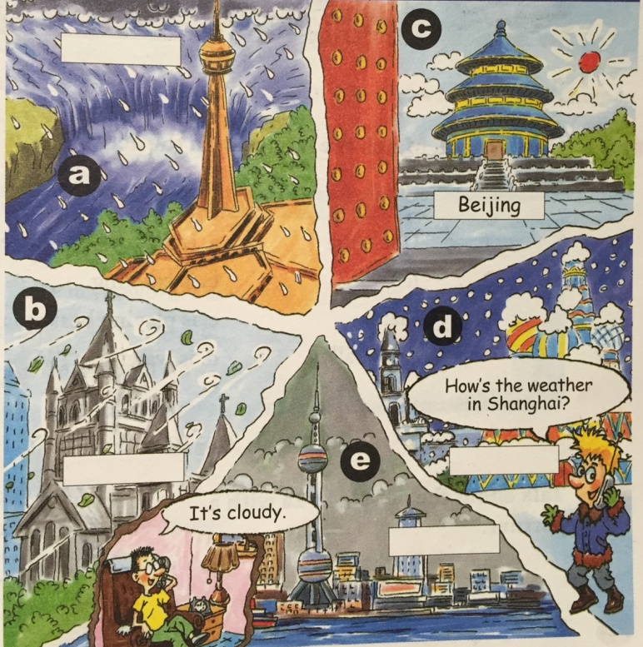
We are tour guide book editors.
Group work--
Choose one of the items, plan the activities for the people in different cities:
(Sydney, Sunny )
(Moscow, Snowy )
(Boston, Windy )
(London, Rainy )

