Slide 1
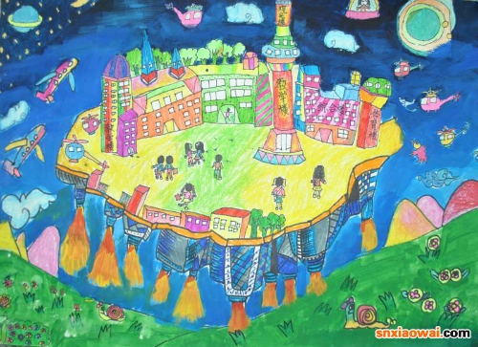
Unit 3 Welcome to our school
Grammar
Zhao Zhe(Allen)
Xincheng Middle School Huangshan Road Campus

Slide 2
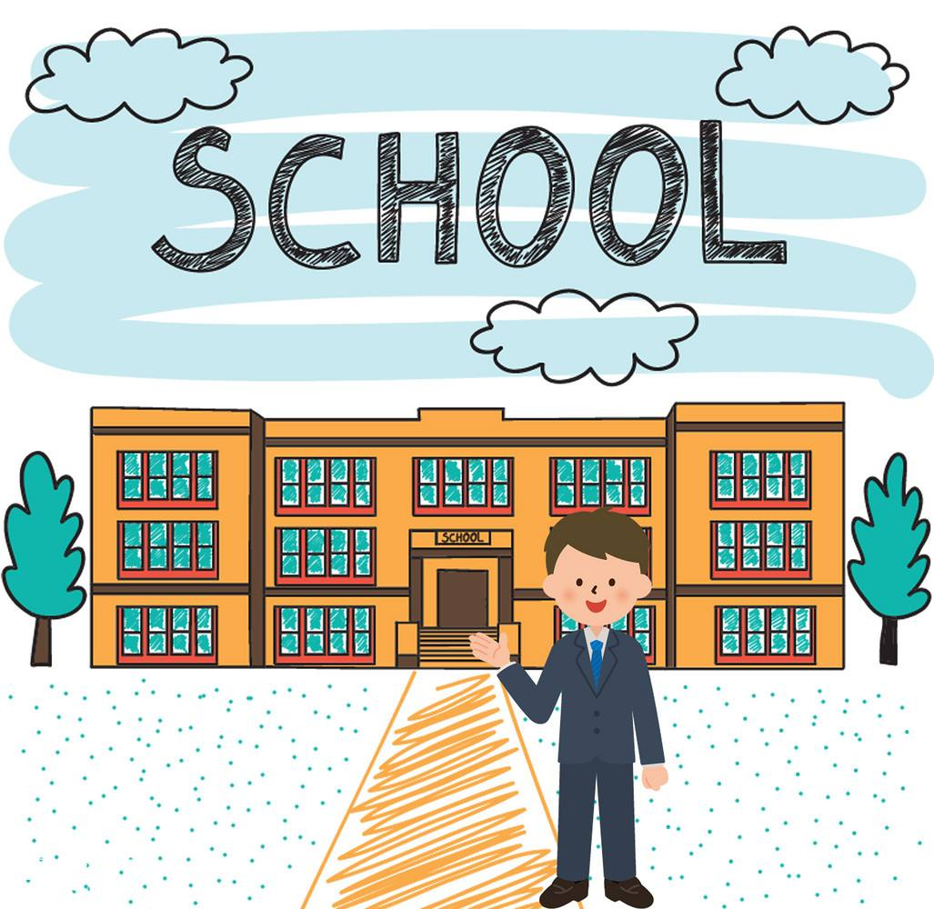
Main task(任务): Introduce(介绍) your new school

Slide 3
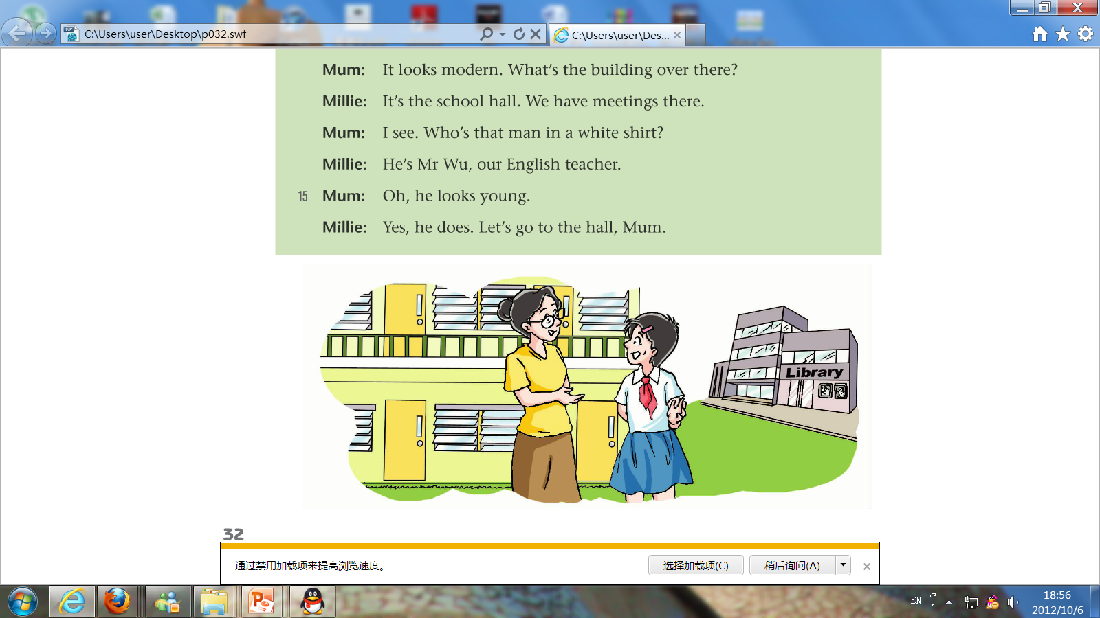
looks beautiful.
Millie's school ____________________
Millie's school ____________________
Millie's school ____________________
It
It
has a big playground.
It
has a modern library.
Personal pronouns（人称代词）
needn't repeat.
Which one is more fluent(流畅)?
an important way to link(衔接) sentences.
Tip:
We should use (nouns(名词)/ personal pronouns) first.

Slide 4
Main task: Introduce your new school
using personal pronouns

Slide 5
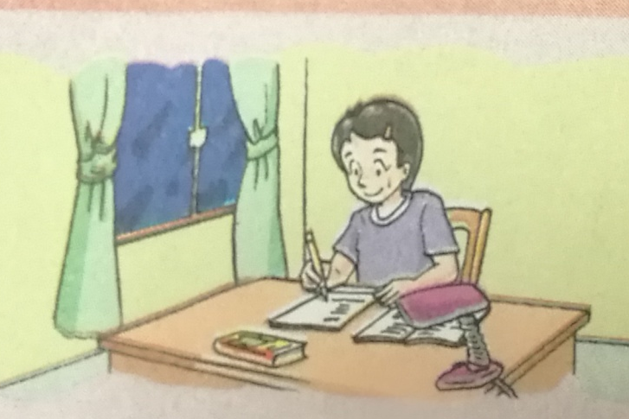
Dear Nancy,
Hello! I miss you so much, but I also start to love the new school. It looks big and beautiful.
I have some new classmates in it and I make a new friend called Sandy. She is hard-working and good at all subjects, so I can learn a lot from her.
The new teachers are all kind. They love us and we love them too. The man in a white shirt is Mr. Wu. He is a new English teacher and often talks to me after class. He enjoys listening to music. It makes him happy.
You are welcome to come here some day!
Yours,
Millie

Slide 6

Difference?
I make a new friend called Sandy.
She is hard-working and good at all subjects,
so I can learn a lot from her.
The man in a white shirt is Mr. Wu.
He enjoys listening to music.
It makes him happy.
At the beginning
Not at the beginning
Subject
pronouns
主格
Object
pronouns
宾格
he, she, us, you, it, him,
they, I, them, her, we, me

Slide 7
Grammatical Persons (人称) | Singular(单数) |  | Plural(复数)
 | Subject Pronouns (主格) | Object Pronouns (宾格) | Subject Pronouns (主格) | Object Pronouns (宾格)
First Person (第一人称)
Second Person (第二人称)
Third Person (第三人称)
Tip:
“You” and ”it” can be both singular(单数) and plural(复数) pronouns.
“You” can also be both a subject(主格) and an object(宾格) pronoun.
I
me
we
us
you
you
you
you
Tip:
We usually use “it” to talk about an animal, an object(物体) or someone whose gender(性别) is not known.
he
him
she
her
they
them
it
it

Slide 8
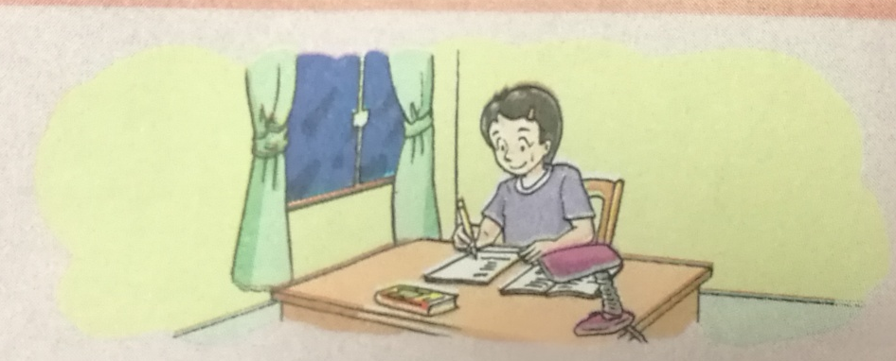

I miss you so much.
It looks big and beautiful.
She is hard-working and good at all subjects.
They love us and we love them too.
He is a new English teacher.
It makes him happy.
You are welcome to come here some day!
I find an English book. Is _____ yours?
it
We usually use subject pronouns(主格) ________ (before/ after) verbs(动词)
before
except(除了) in questions.

Slide 9
Exercise: My friends (Page 1)
Millie: Mum, look at the pictures of my friends on the wall.
Mum: OK. Let me see. Is this Daniel?
Millie: Yes, it is. Daniel is clever. ______ is good at Maths.
Mum: Is that Simon, Millie?
Millie: Yes, Mum. Simon is tall. ______ is in our school
Mum: This is Kitty, I think.
Millie: No, this is Amy. ______ has short hair. That's Kitty.
Mum: Oh, yes. _____________are good friends, right?
Millie: Yes, Mum. ______ are all very nice. ______ love them.
He
He
football team.
She
______ has long hair.
She
You/ They
?
They
I
Tip:
We use ________(the same/different) personal pronouns according to(根据)
different
different contexts(语境).

Slide 10
I miss you so much.
They love us and we love them too.
It makes him happy.
after
We usually use object pronouns(宾格) ________ (before/ after) verbs(动词).
I have some new classmates in it.
so I can learn a lot from her.
He is a new English teacher and often talks to me.
after
We usually use object pronouns(宾格) ________ (before/ after) prepositions(介词).

Slide 11
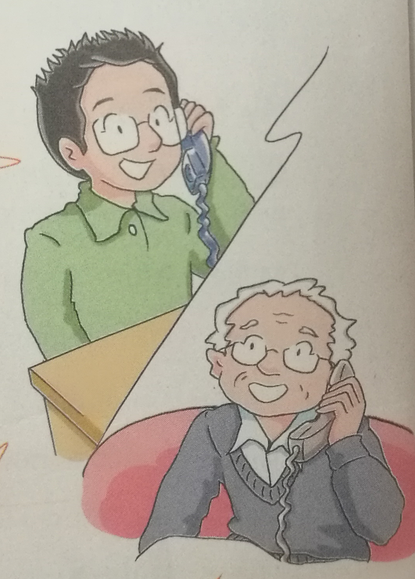
Exercise: On the phone( Page 2)
I'm at a new school, Grandpa. Let me tell you about ______.
it
Mr. Wu is our English teacher. We all like ______.
him
I have some new friends. I like to play with ______ after class.
them
I'm not good at English. Sometimes Millie helps ______.
Tip:
We use personal pronouns according to (the rules/ the context).
me
Is Grandma at home now? I want to say hello to ______.
(规则)
(依据)
(语境)
her
you
Pardon? Daniel, I can't hear ______ well on the phone.
him?

Slide 12
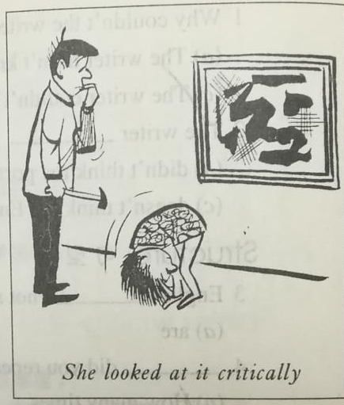
Exercise: John and her sister
John is an art student and John draws some pictures. Many people say that many people understand modern art but many pictures are not “about” anything.
he
They
they
John's sister is only seven, but John's sister often tells John something about the pictures.
“What is John doing?” John's sister asks.
“John is hanging this picture on the wall,” John answers.
“This picture looks all right, but isn't this picture upside down(上下颠倒)?“
John looks at it again. She is right!
she
are you
I'm
it

Slide 13
Main task: Introduce your new school
using personal pronouns

Slide 14
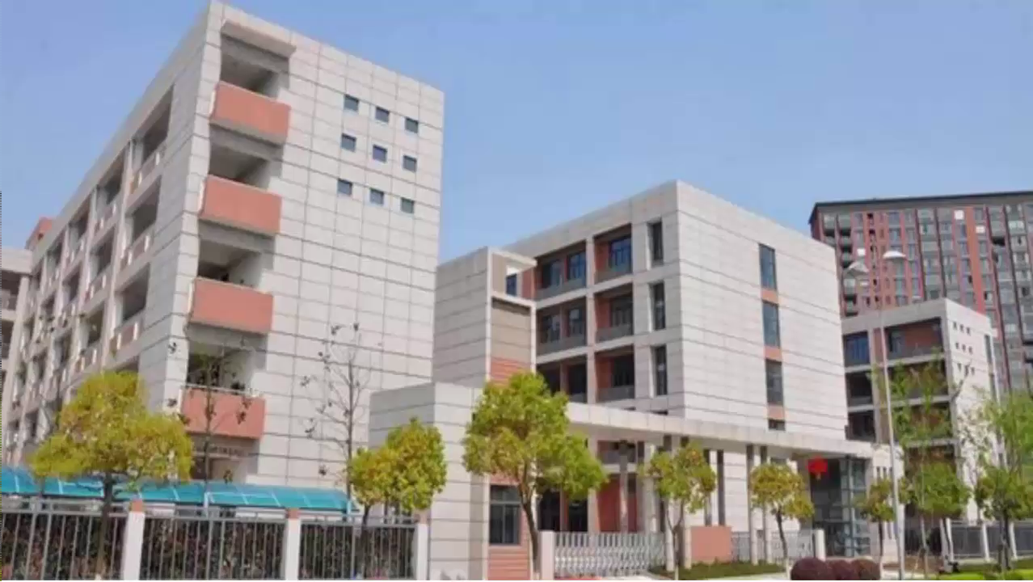

Slide 15
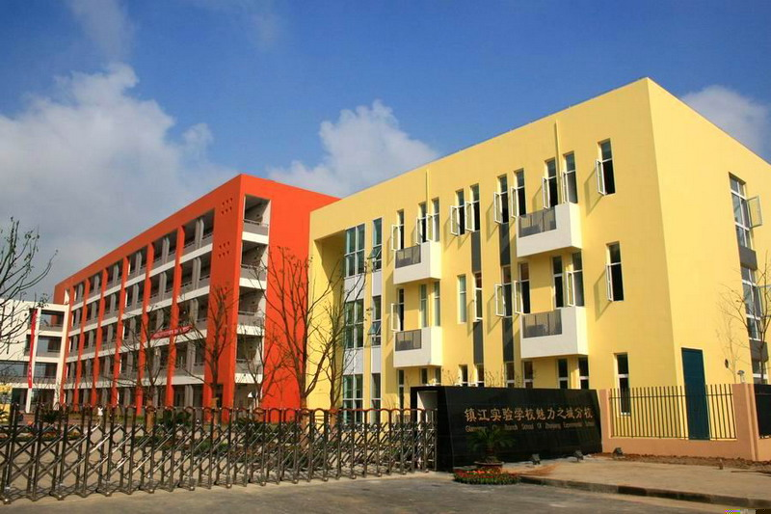
Name and different rooms
Which school do you study at?
What do you think of it?
What rooms do you have and what can you do in them?

Slide 16
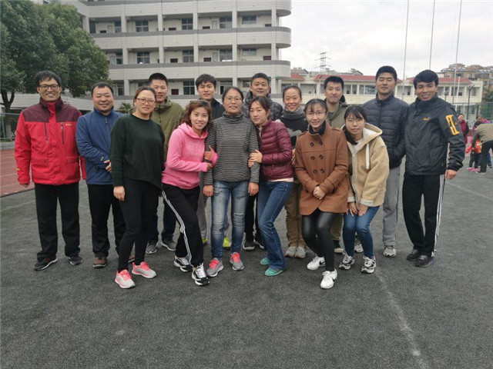
Teachers
Who are they?
Do you like your teachers?
Why do you like them?

Slide 17
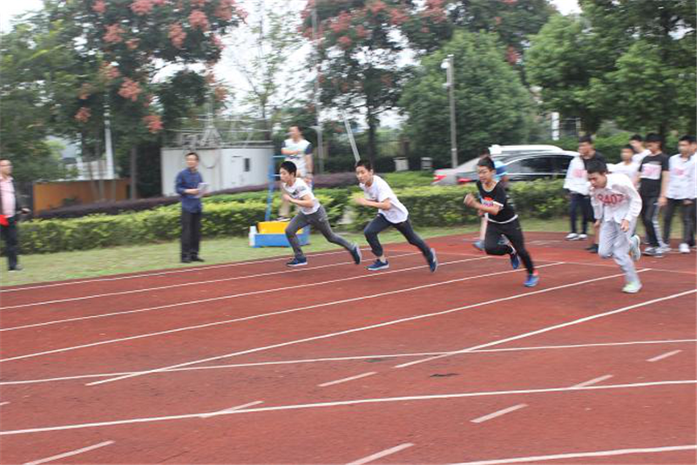
Classmates and friends
What are they doing?
Do you like your classmates?
What do you usually do with them after class?

Slide 18
Group work: Introduce your new school
Student A:
Name and different rooms
Student B:
Teachers
Student C:
Classmates and friends
Student D:
Reporter(汇报者)
At least 2 sentences and 2 personal pronouns

Slide 19
Name and different rooms
I am a student at.../ I study at...
It looks...
We have... and we can... in them.
Our... is in front of ... and ... is... We can...in it.
Teachers
Our teachers are... and I like... because...
... is our... teacher and... looks...
Classmates and friends
... is my friend and he/she is...
I often... with...
Reporter(汇报者)
Hello, everyone!
Welcome to our school!
linking words(连词)

Slide 20
What do you learn from this class?
Grammatical Persons （人称） | Singuar（单数） |  | Plural（复数）
 | Subject pronouns （主格） | Object pronouns （宾格） | Subject pronouns （主格） | Object pronouns （宾格）
First Person （第一人称）
Second Person （第二人称）
Third Person （第三人称）
I
me
we
us
you
you
you
you
he
him
she
her
they
them
it
it

Slide 21
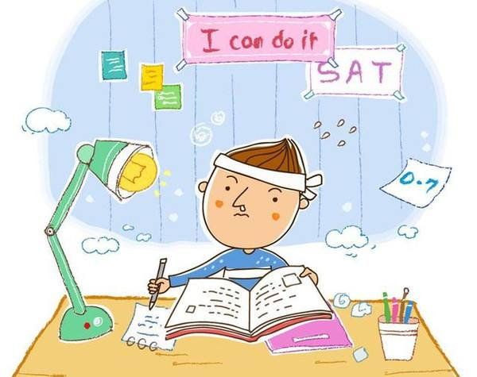
Homework
Write a short paragraph of your school life using at least 6 pronouns.

