Slide 1
人教版《新目标》八年级下册 Unit 4
Why don’t you talk to your parents?
Section A
课型：听说课

Slide 2
Teaching Aims:
1
Use the sentence patterns to talk politely.
2
Use the skills to talk successfully.
3
Form the habit of talking to parents.
Predict listening information.
4

Slide 3
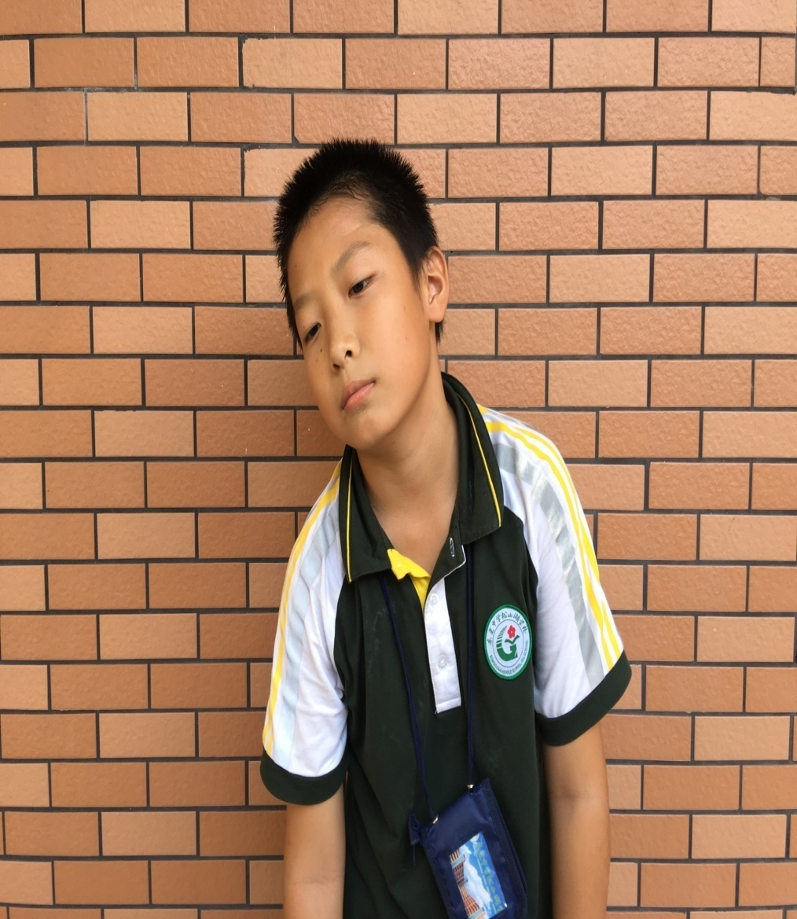
I am so sad!
Tom

Slide 4
He can’t go to Mary’s party.
Tom’s problem:
Mum’s reason:
Tom has an exam on Monday.
Notes:
字要大，42以上 要给答案

Slide 5
We may have problems like Tom’s.

Slide 6
I want to _____, but my parents_____.

Slide 7
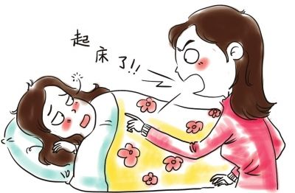
I don’t want to .
but my parents __ __ _____.
Notes:
补习班，做作业，看书，蔬菜，

Slide 8
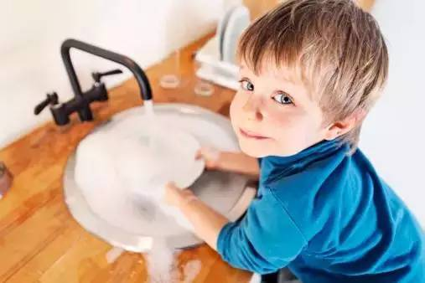
What other problems do you have?
I want to______ , but my parents________ .
I don’t want to____ , but my parents_____ .

Slide 9
What is the best way to solve these problems?
Notes:
过度过渡！！！

Slide 10
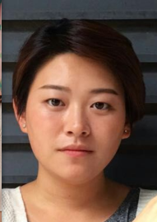
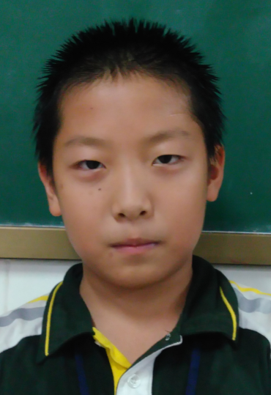
Could Tom go to the party?
2. What do you think of the talk?

Slide 11
Notes:
重拍

Slide 12
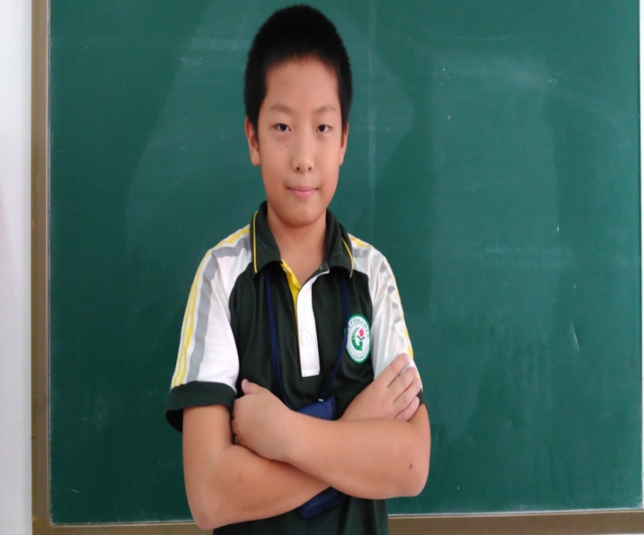
1. Could Tom go to the party?
2. What do you think of the talk?
I have powerful skills(绝招)!
Notes:
美观，过渡 背景

Slide 13
4 powerful skills（四大绝招）: P F R P ?
Notes:
降噪

Slide 14
4 powerful skills: P F R P ?
 | Mum, _____ I talk to you for a second?
 | I feel these days.
 | …because Mary is________________. She helps me a lot with__________.
 | I promise I will____________the exam. I will come back home ______ with friends.
P
oliteness
may
F
so sad
eeling
my best friend
R
eason
my study
study for
P
romise
early
Notes:
任务二：转入听力。音频！！！ 听句子

Slide 15
When we are talking to our parents…
P
F
Be polite.
Tell feelings.
R
P
Tell reasons.
Make promises.
Notes:
如何过渡到训练营 改气球 锦囊或宝盒 思考BE…或BEING 字放在框里面，be …

Slide 16
Powerful Skills Training. 谈话绝招训练营
1. Find the task. 找到任务。
2. Discuss the questions. 讨论问题。
3. Write down the answers. 写下答案。（至少3个句子）
4. Show time! 上台展示。
P
F
R
P

Slide 17
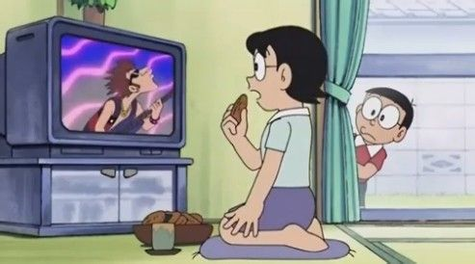
Powerful Skills Training. 谈话绝招训练营
politeness
Your mum is watching TV on the sofa.
You need her help.
How can you start the talk politely?
Notes:
学生念任务

Slide 18
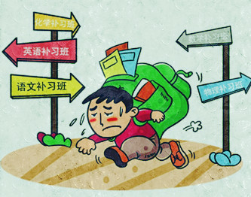
Powerful Skills Training. 谈话绝招训练营
feeling
Your dad asks you to take after school classes,
but you don’t like it.
How can you tell your feelings?
Notes:
要不要左缩进？更多的提醒

Slide 19
Powerful Skills Training. 谈话绝招训练营
reason
You don’t want to take after school classes. Please tell your dad the reasons.
Notes:
必杀技训练营 一张综合，杨睿捧开双手，四颗明珠，超链接

Slide 20
Powerful Skills Training. 谈话绝招训练营
promise
Your parents worry about your study, so what promises can you make?
Notes:
过渡到下一步很重要

Slide 22
Role-Play 家庭剧表演
Mary
After School Classes
1. One acts as Mum or dad, one as Mary.
2. Mary is trying to persuade(说服) her parents.
3. You need to:
1) Use PFRP skills 2)Act naturally(表演自然）
3) Be creative(有创意) 4) Be humorous(幽默的）
Notes:
加入录音

Slide 23
Someone like Tom
-- made and sung by Justin
Never mind, I will find some Tom like you.
I wish nothing but the best for you too.
P, F, R, P. I beg.
You remember I said.

Slide 24
Sometimes talk to mum,
and sometimes talk to dad.
Sometimes talk to mum,
and sometimes talk to dad.

Slide 25
Homework
思考并寻找一件需要与父母交流解决的事情，运用本节课所学技巧与父母沟通，在谈话结束后用英语写一篇感想。

Slide 26
Thank you so much!
I love you all!

