Slide 1
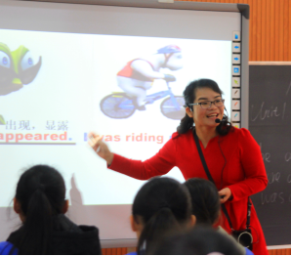
第十二届初中英语课堂教学观摩培训
Let’s enjoy our class!
韦灵
广西柳州市
第二十四中学

Slide 2
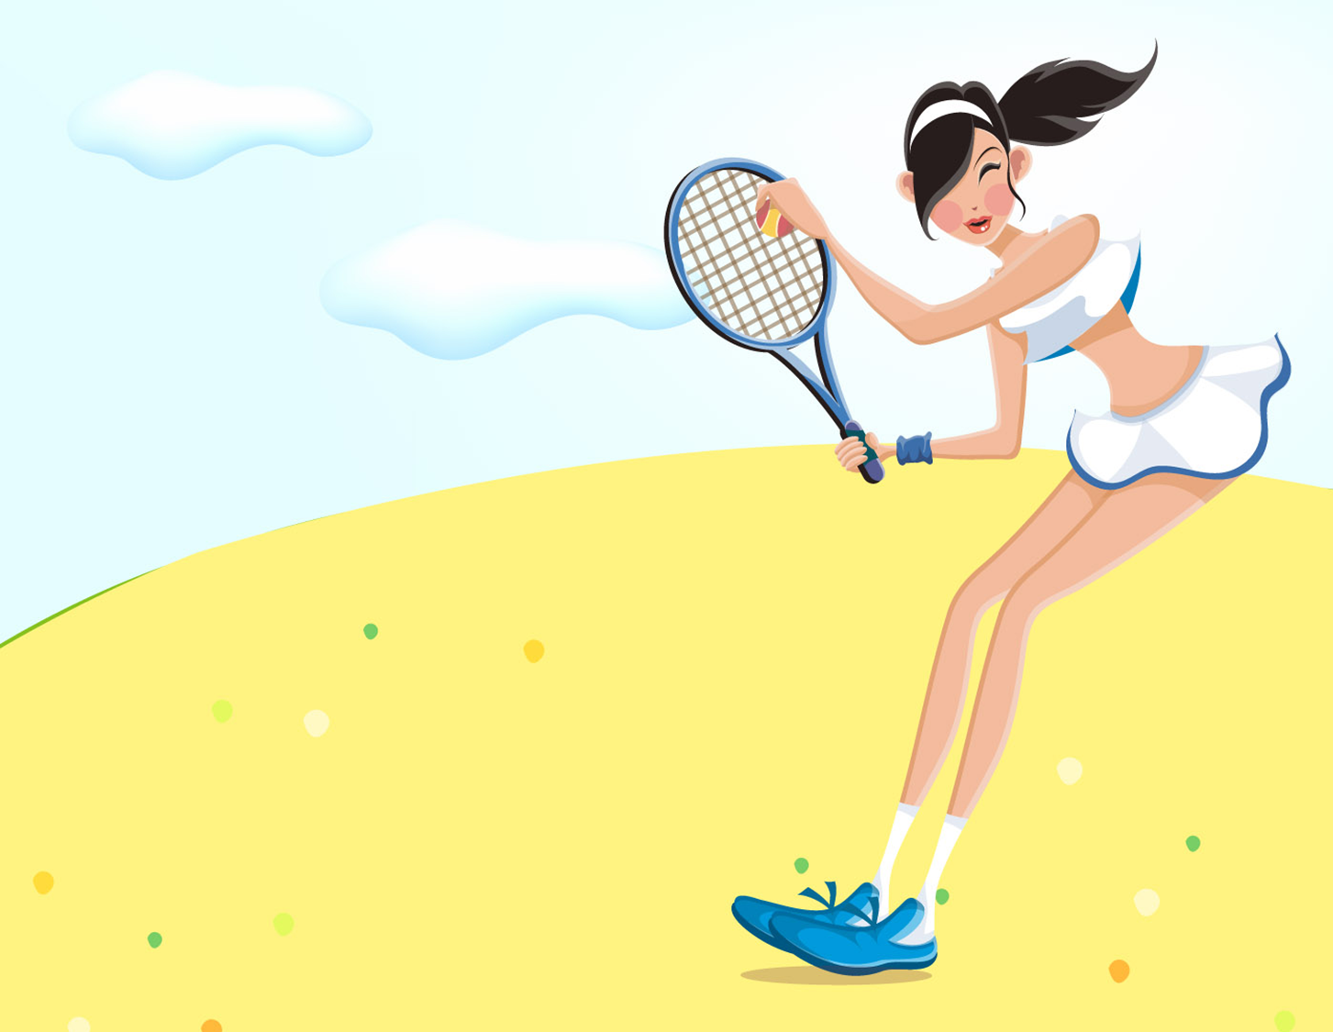
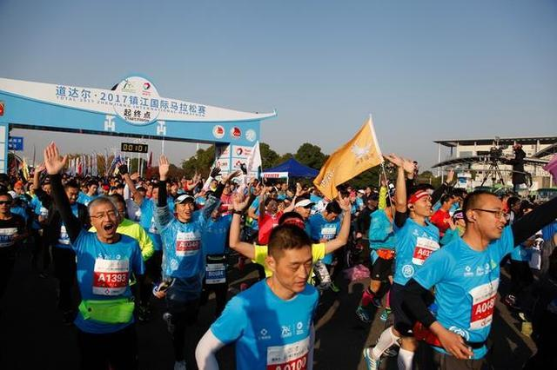
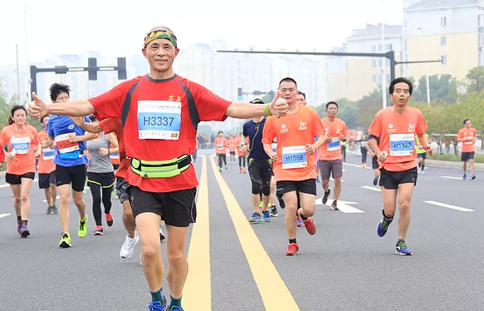
Module 3 Sports
Unit1 Nothing is more
enjoyable than playing tennis.
/in′dʒɔiəbl/
执教者：柳州市第二十四中学 韦灵

Slide 3
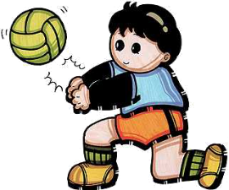
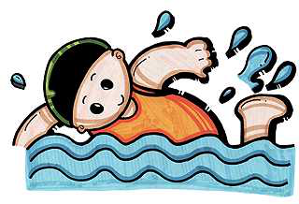
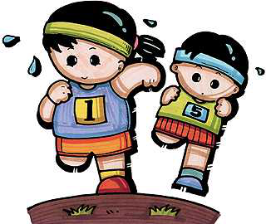
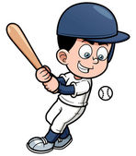
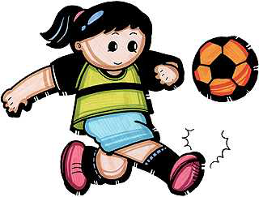
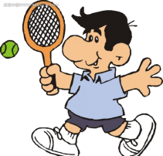
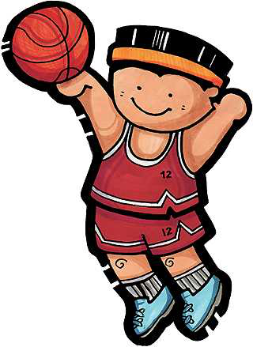
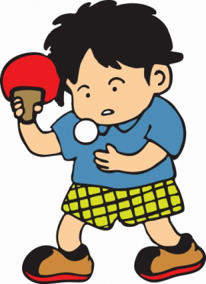
/′vɔlibɔ:l/
volleyball
/′beisbɔ:l/
baseball
sports

Slide 4
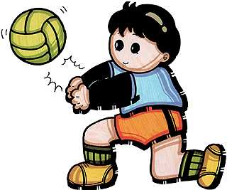
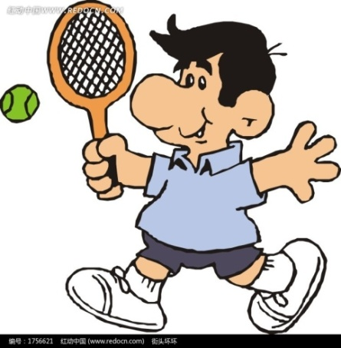
My favorite sport is________________.
It’s___________.
interesting
popular expensive
dangerous difficult...

Slide 5
Listen and finish the exercises.
1. What is Daming’s favorite sport?
A. Basketball B. Football C. Swimming
2. Football is _______________than baseball.
popular
B. more exciting
C. interesting

Slide 6
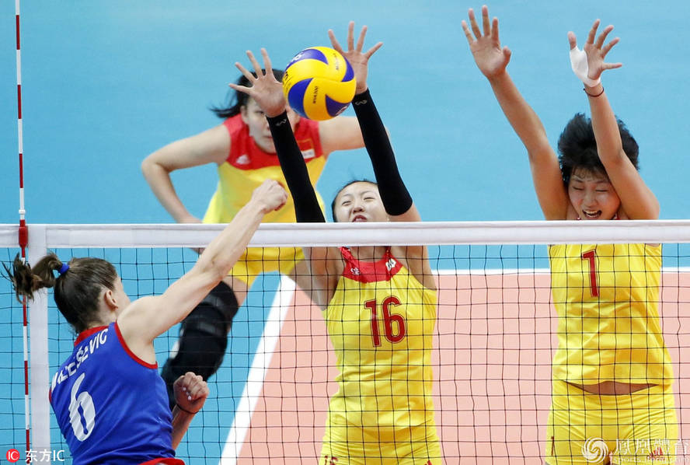
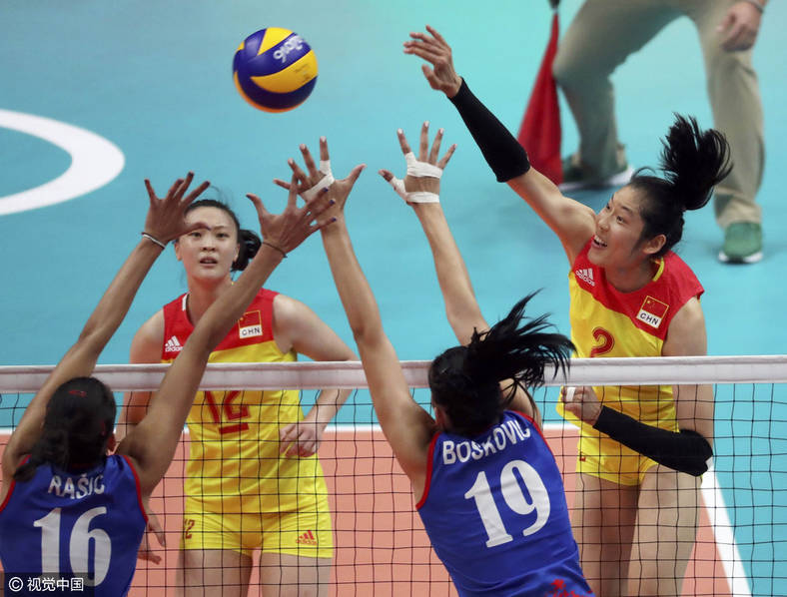
A volleyball match

Slide 7
Volleyball match was very _______.
I am ______.

Slide 8
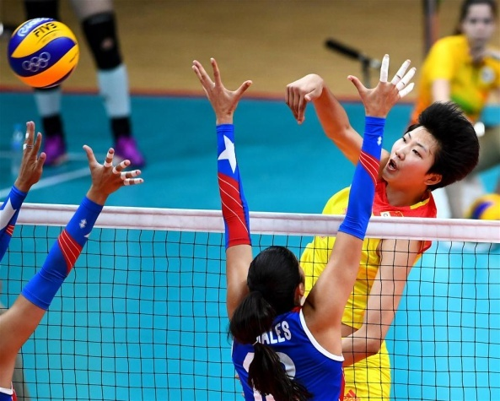
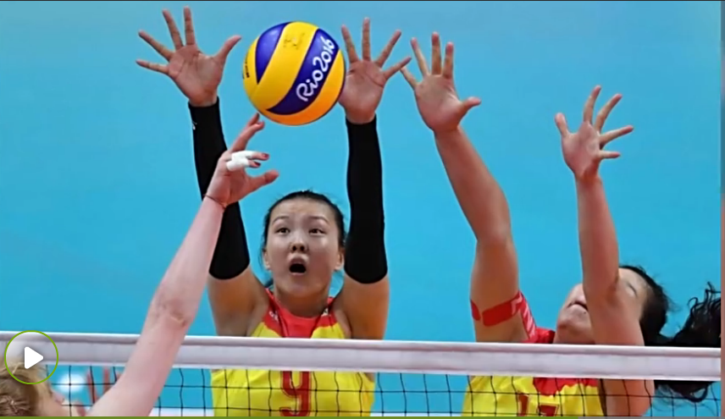
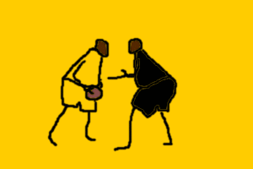
Hui Ruoqi scored.
/skɔ:/ 得分

Slide 9
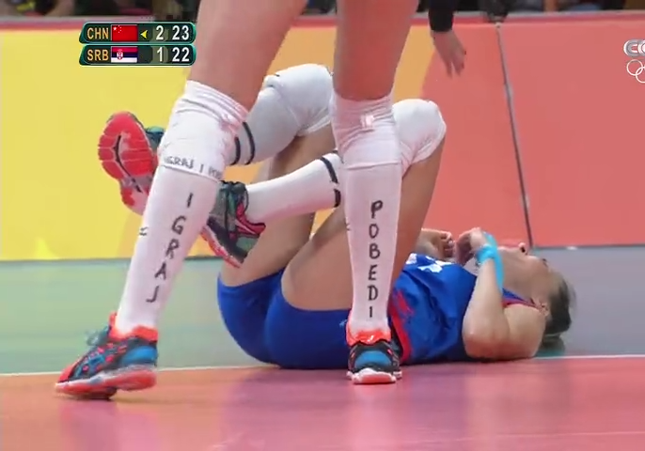
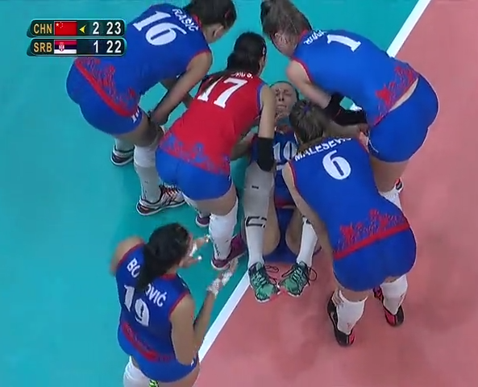
---What’s the matter with the girl?
---She hurt her face.
/hə:t/

Slide 10
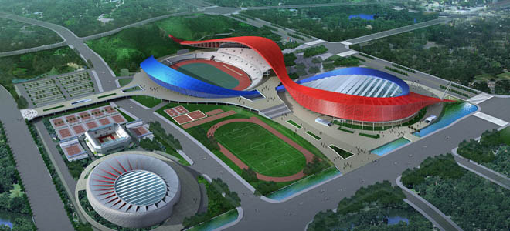
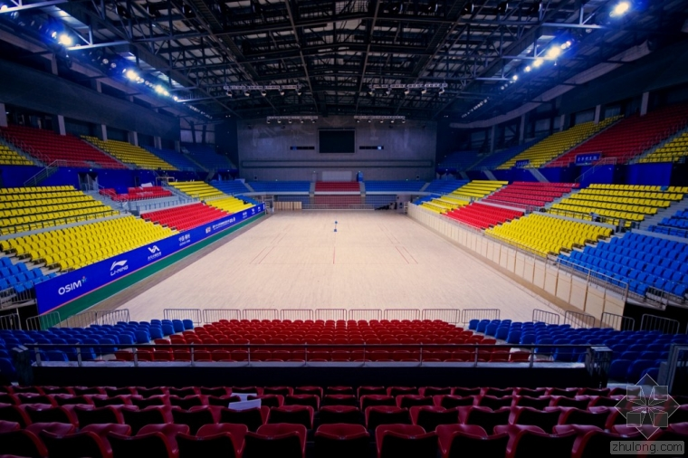
There will be a baseball match
and a volleyball match in Zhengjiang Stadium next week.
/′steidium/

Slide 11
watching the
match on TV
going to
the stadium

Slide 12
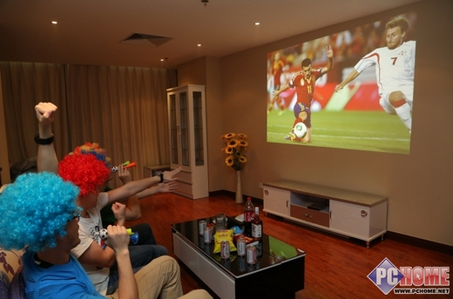
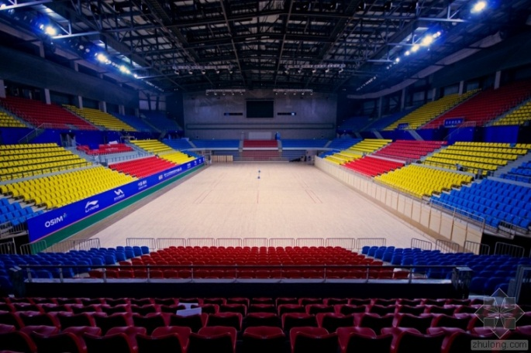
easy--easier
safe--safer
exciting--more exciting
cheap--cheaper
interesting--more interesting
comfortable--more comfortable
easier
more relaxing
more boring
Watching the match on TV is ___________ than going to the stadium.
relaxing
boring
令人轻松的
/′bɔ:riŋ/无聊的
/ri′læksiŋ/

Slide 13
Volleyball match is more_______ than baseball match.
Baseball match is more______ than volleyball match .
more exciting more interesting
more relaxing more enjoyable
more popular more expensive
more dangerous more difficult...

Slide 14
Pair-work
A: Hey, _____. Which sport do you like,____or____?
B: I like____. It is ____than____.
more exciting more interesting
more relaxing more enjoyable
more popular more expensive
more dangerous more difficult...
safer cheaper easier

Slide 15
Watch and answer questions.
1. What matches do they mention(提到) ?
A football match, a tennis match and Olympics.

Slide 16
Listen and check() the true sentences.

1. This week’s match is more exciting than last week’s.
2. Tony plays table tennis yesterday.
3. For Tony, playing tennis is more enjoyable than watching matches on TV.
4. Watching the Olympics on TV was more expensive than buying tickets for the games.
5. Going to the stadium was more difficult than staying at home.



Slide 18
Can you find any rules(规则)?
enjoyable---more enjoyable
exciting---
popular---
relaxing---
more exciting
more popular
more relaxing
more + adj （多音节和部分双音节形容词的比较级形式）

Slide 19
1. Change the following words into comparative adjectives. (将下列形容词变成比较级形式)
⑪……
⑩……
2. 40seconds！(每组40秒的时间)
⑨……
3. 11 players！(每组11位运动员)
⑧……
⑦……
⑥hot
Running Brains
⑤old
④small
③dangerous
②expensive
①beautiful

Slide 20
Please change these words into comparative adjectives. 请将这
些词变成形容词比较级
40
⑪old
30
⑩tall
⑨wide
20
Go
ahead!
⑧large
10
⑦safe
Go! Go!
Go!
⑥popular
00
⑤comfortable
Go
④dangerous
③relaxing
②expensive
①exciting
Time’s up!

Slide 21
Please change these words into comparative adjectives. 请将这
些词变成形容词比较级
40
⑪new
30
⑩busy
⑨wide
20
Go
ahead!
⑧clean
10
⑦easy
Go! Go!
Go!
⑥difficult
00
⑤beautiful
Go
④interesting
③boring
②exciting
①enjoyable
Time’s up!

Slide 22
Join us!
We need you!

Slide 23
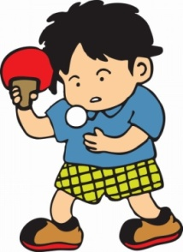
A: Hello. I want to join a club.
B: Welcome! Nothing is ____than____.
C: No, no, no. ___is ____.
D: Hi. Why not join our ___club. It is (more)_____.
A: Thanks a lot. I'd like to join___club. It's ___ for me.
safer cheaper easier
more exciting more interesting
more relaxing more enjoyable
more popular more expensive
more dangerous more difficult...

Slide 24
A: Hello. I want to join a club.
B: Welcome! Nothing is ____than____.
C: No, no, no. ___is ____.
D: Hi. Why not join our ___club. It is (more)_____.
A: Thanks a lot. I'd like to join___club. It's ___ for me.

Slide 25
A: Hello. I want to join a club.
B: Welcome! Nothing is ____than____.
C:No, no, no. ___is ____.
D: Hi. Why not join our ___club. It is (more)_____.
A: Thanks a lot. I'd like to join___club. It's ___ for me.
safer cheaper easier
more exciting more interesting
more relaxing more enjoyable
more popular more expensive
more dangerous more difficult...

Slide 26
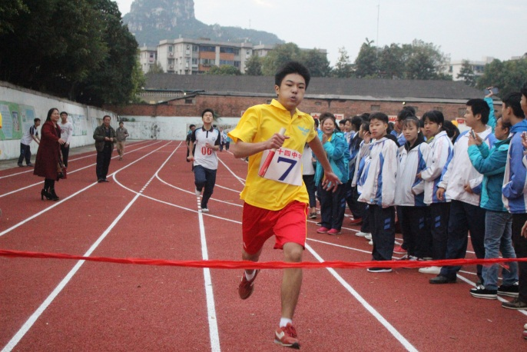
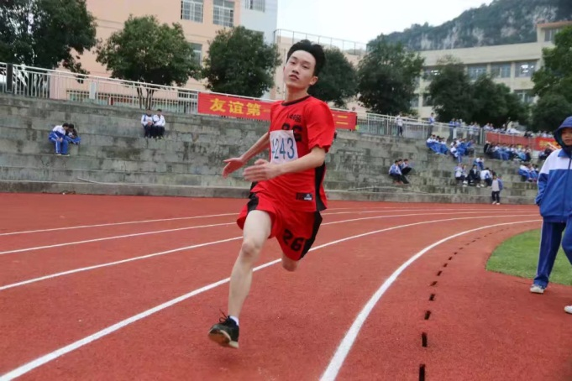
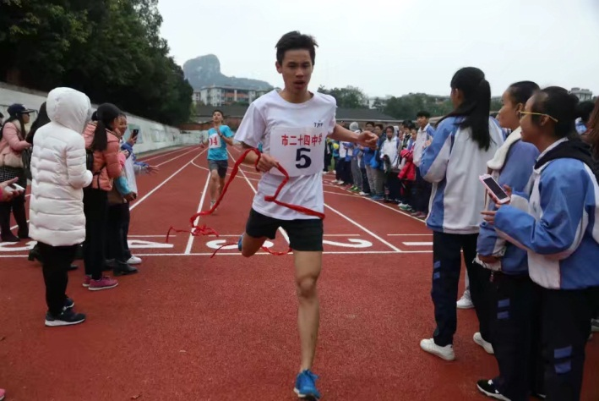
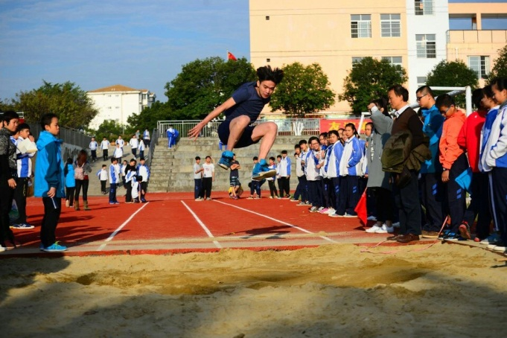
Enjoy sports! To be a hero for yourself and your class!

Slide 27
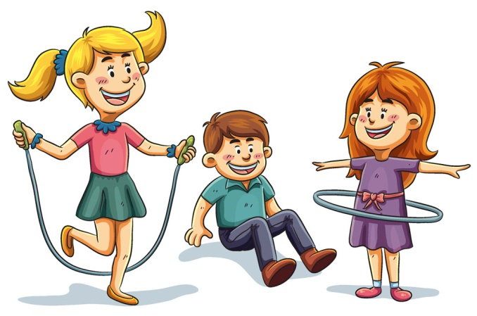
1. Do sports with your families
and take some photos.
2. Talk about your favorite sport with
What we have learned today.

