Slide 1
It’s my Dream.
北京景山学校 王翀

Slide 2
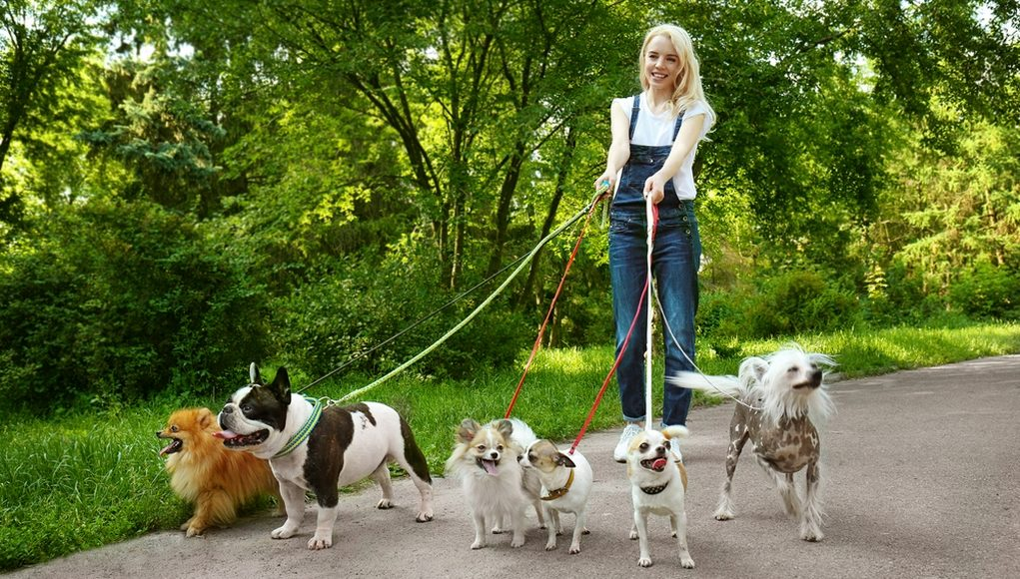
for students in England
Part-time jobs

Slide 3
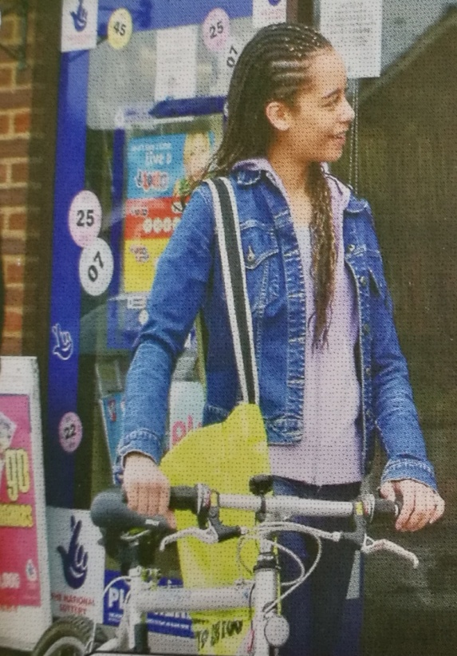
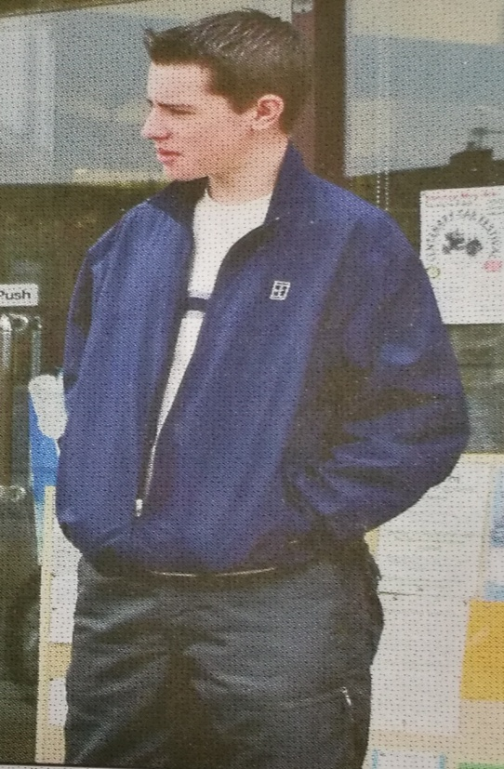
Amy
Dave
Guess: What aspects (方面) of the job
do they talk about?

Slide 4
Listen and find out the key information about Amy’s job.
“Isn’t it a lot of work for hardly any money?”

Slide 5
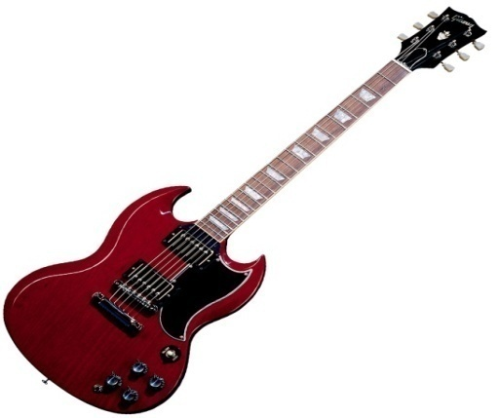
Listen and find out why Amy does the job.
“I’m doing it for a reason!”
“I’m saving up for a good guitar.”

Slide 6
Match the words and expressions 1-4 in the conversation with expressions a-d.
1. pocket money
2. mind
3. saving up
4. hardly any money
a. money that parents give their children every week or every month
b. almost no money
c. keeping money for future use
d. dislike/be troubled by

Slide 7
Read the conversation aloud with the recording.
Pay attention to
the pronunciation and intonation!

Slide 8
Discuss in groups.
What do you think of Amy?

Slide 9
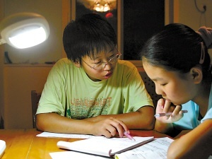
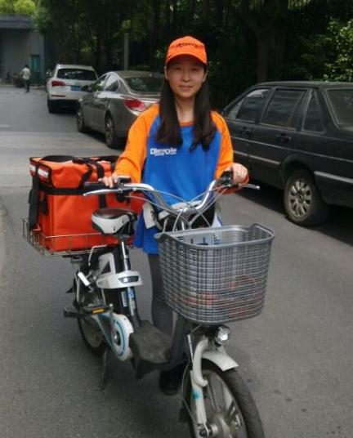
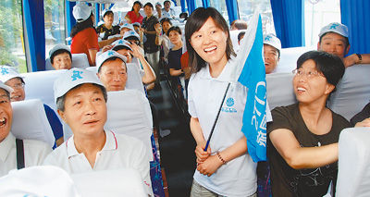
Some part-time jobs for students in China
tutor
waiter/waitress
delivery man/woman
tour guide

Slide 10
Discuss in pairs.
Do you want to do a part-time job?
If YES, what job do you want to do? Why?
…
If NO, why not?

Slide 11
Read the passages about students doing part-time jobs.
2. Finish the vocabulary exercise.

Slide 12
ericawang111@126.com

Slide 13
do a paper round
take newspapers to people’s houses

