Slide 1
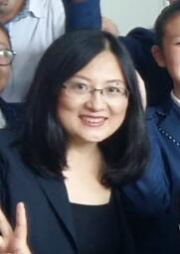
英语高级教师，现就职于辽宁省大连市经济技术开发区第九中学。
毕业于大连外国语大学英语学院。
曾获得国家、省、市级英语优质课、精品课等奖项。
张海燕老师

Slide 2
外研社 九年级 上册
Module 4 - Home alone
Unit 2 My “perfect holiday”
授课教师：张海燕
辽宁省大连经济技术开发区第九中学

Slide 3
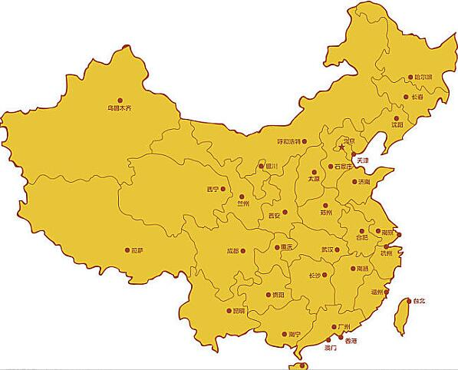
大连
镇江

Slide 4
?

Slide 5
1
The passage is_____.
A. A narrative writing(叙事文)
B. A descriptive writing(描写文)
C. An expositive writing(说明文)
D. A persuasive writing(观点文)
4
2
5
3

Slide 6
1
4
2
5
3

Slide 7
1
4
2
Story
5
3

Slide 8
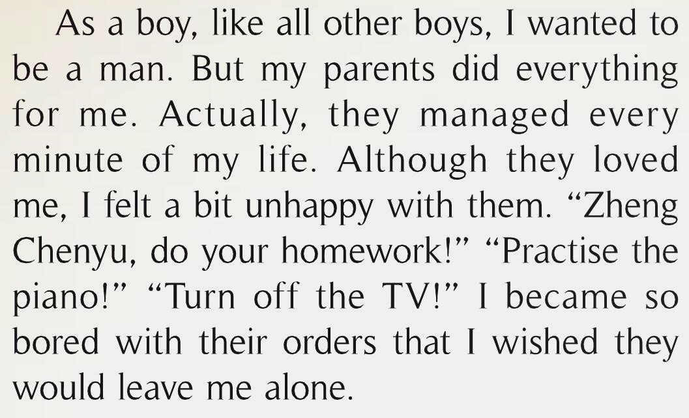
Comprehension check -- Background:
1
?

Slide 9
1
4
2
Story
5
3

Slide 10
Comprehension check -- Story:
The “home alone” story – Para ❷❸❹
What made Zheng Chenyu’s wish come true(实现)?
What did the boy do to have fun on the first day?
What happened to the boy at school the next day?
What did the boy think of(认为,看待)his home alone holiday?

Slide 11
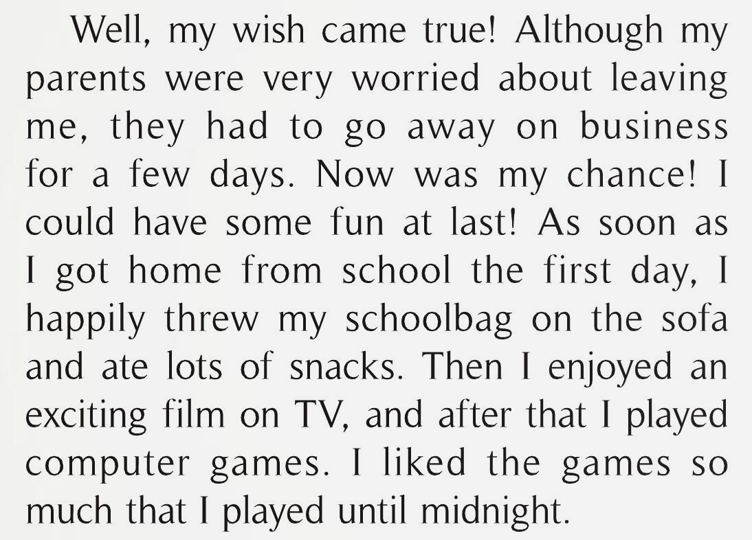
Comprehension check -- Story:
2
Q: What does “chance” here refer to(指代)?
Q:What made Zheng’ wish come true?
What did the boy do to have fun on the first day?

Slide 12
Comprehension check -- Story:
3
Q:What happened to him at school the next day?

Slide 13
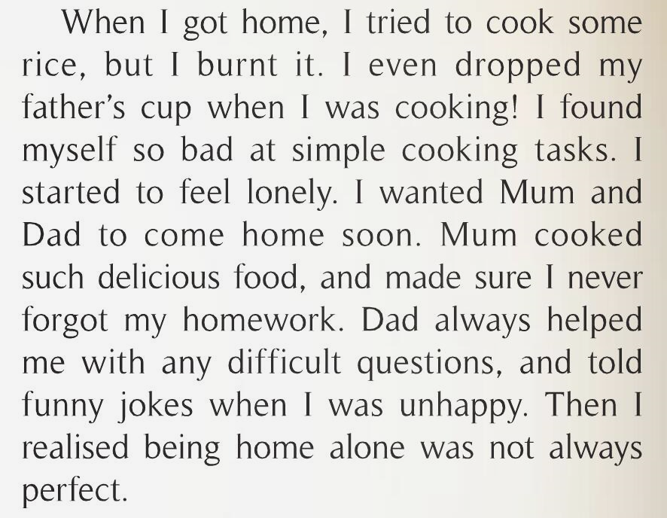
Comprehension check – Story:
4
What he learned from his story
lesson!
Q: What did the boy think of(认为,看待) his home alone holiday?

Slide 14
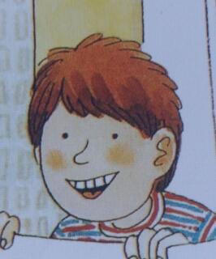
Comprehension check -- Ending:
5
A smile of understanding

Slide 15
The story is organized(组织) by _______________________.
the boy’s feelings change

Slide 16
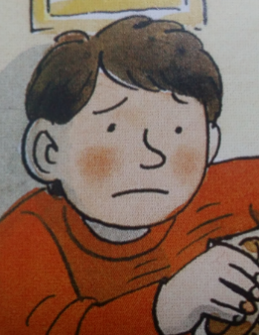
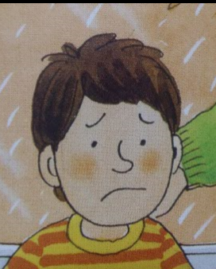
Q: Let’s retell Zheng Chenyu’s home alone story in the third person briefly.
(请以第三人称简略地复述郑晨宇独自在家的经历)
Orders
Chance
bored
excited
Lesson?
You can retell like this:
Zheng felt bored with his parents’ orders because they did everything for him.
Day1
happy
Trouble
Trouble
tired & sleepy
lonely
Day2
Day2-evening

Slide 17
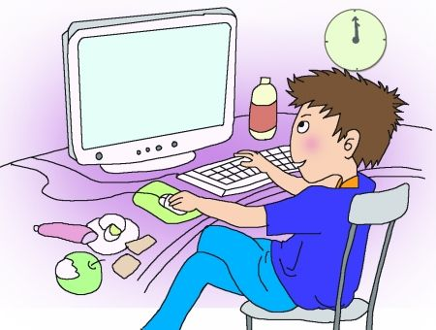
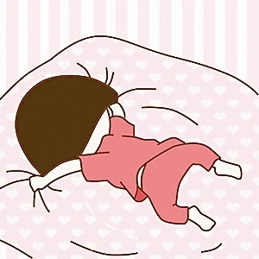
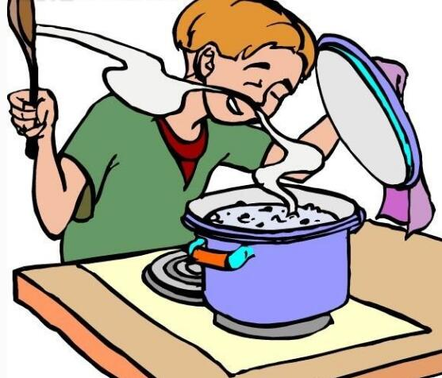
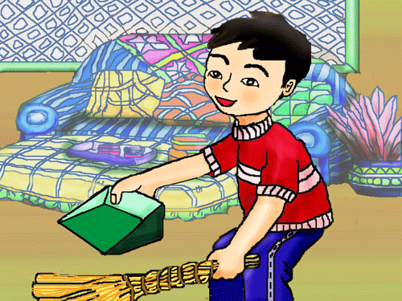
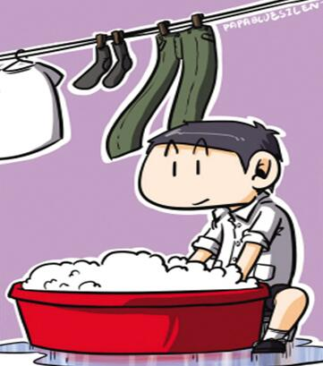
Further thinking:
Q1: Do you think the boy wants another chance to be home alone? Why or why not?
Q2: What do you learn from the boy’s story?
Parents’ orders are always boring(令人厌烦的)?
What do you learn about how to have a perfect home alone holiday from the boy’s story?
What do you think of(看待) the daily things that parents do for you?
I think/ I learn/ I realise that…
games

Slide 18
Homework:
You must:
A: Read the passage emotionally and experience the writer's feeling change.
B: Tell the boy’s home alone story in the third person within about 90 words.
You may:
C: Tell your own home alone story to your friends if you have such an experience.

